Slide 1
Predicting essential genes via impact degree on metabolic networks
ISSSB’11
Takeyuki Tamura
Bioinformatics Center,
Institute for Chemical Research
Kyoto University, Japan

Slide 2
Essential genes, lethal pairs
E. coli K12 has more than 4000 coding genes.
By checking cell growth rate of single knockout of each gene, only 303 genes are identified as essential for growth in rich medium. (Baba et al. 2006)
Screening of cell growth rate of double knockouts are ongoing on E. coli and S. Cerevisiae by some biological groups.
Although these experiments will be completed in a few years, reasons why these single (double) knockouts are essential (or lethal) will not be directly revealed.

Slide 3
Aim of the research
The aim of this research is to reveal how each single (or double) knockout affects cell growth rates in silico especially on metabolic networks.
To do so, some mathematical model for metabolic networks and gene knockouts is necessary.
  A good model may predict the effect of double knockouts, triple knockouts…
As the first step of the study, we extend the impact degree model (Jiang et al. 2009) , which is a combination of Boolean model and flux balance model, to asses the effect of gene knockouts on metabolic networks.
As a result of computer experiments, it Is seen that genes with high impact degree tend to be essential for single knockouts.

Slide 4
Model of metabolic network
C
Flux balance model
1
A
2
(Papin et al. 2003, Stelling et al. 2002)
1
reaction 1
2
B
2
1
For reaction 1
A + 2B → 2C + D
For reaction 2
E + F → D
For each reaction,
ratio of compounds
must be satisfied.
2
D
2
E
1
1
1
For each compound,
the sum of incoming flow
must equal to
the sum of outgoing flow.
F
1
1
reaction 2
E
Boolean model
A
∨
reaction 1
∨
(Sridhar et al. 2008)
∧
F
B
∨
For each compound,
amount is represented
only by 1(exist) or 0(not exist).
∨
C
∨
target
compound
∧
For each reaction,
state is represented
only by 1(occur) or 0(not occur).
D
∨
reaction 2

Slide 5
Boolean model of metabolic network
Source nodes, whose indegrees are 0, are
always assigned 1 (exist, producible).
inactivate
C
reaction 2
Source node
∨
∧
target
compound
A
reaction 1
D
∨
∨
G
∨
∧
B
E
∨
∨
inactivate
Source node
∧
F
∨
reaction 3
Which reactions should be inactivated so that the target compound becomes non-producible (assigned 0)?

Slide 6
Boolean model of metabolic network
Source nodes whose indegrees are 0 are
always assigned 1.
C
reaction 2
Source node
inactivate
∨
∧
target
compound
A
reaction 1
D
∨
G
∨
∧
B
E
∨
Source node
∧
F
∨
reaction 3
Which reactions should be inactivated so that the target compound becomes non-producible (assigned 0)?

Slide 7


Impact degree model of metabolic network
The impact degree model (Jiang et al. 2009) is a kind of Boolean model focusing on steady states.
Different from usual Boolean model, each node is affected by its successors.
  To be active, not only predecessors but also successors must be active in steady states.
C1
C3
R1
R3
R1
C1
C2
C4
R2
R4
$R_{1}$=($C_{1}$∧$C_{2}$)∧($C_{3}∧C_{4}$)
$C_{1}$=($R_{1}∨R_{2}$)∧($R_{3}∨R_{4}$)

Slide 8


Impact degree model of metabolic network
The impact degree is defined as the number of reactions inactivated by deleting a specified reaction (or a set of specified reactions). (Jiang et al. 2009)
Since cycles are not taken into account in their method, we extend the definition of impact degree so that cycles can be treated.
  Cycles may yield multiple stable states.
  Assume all nodes are active initially.
C1
C3
R1
R3
R1
C1
C2
C4
R2
R4
$R_{1}$=($C_{1}$∧$C_{2}$)∧($C_{3}∧C_{4}$)
$C_{1}$=($R_{1}∨R_{2}$)∧($R_{3}∨R_{4}$)

Slide 9
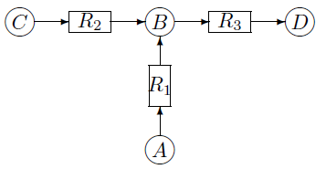



Example 1
To calculate the impact degree of reaction R1.
t=1
A(1)=0,
B(1)=1,
C(1)=1,
D(1)=1,
R1(1)=0,
R2(1)=1,
R3(1)=1,
t=2
A(2)=0,
B(2)=1,
C(2)=1,
D(2)=1,
R1(2)=0,
R2(2)=1,
R3(2)=1,
For compounds
For reactions
Thus, the impact degree for reaction R1 is 1.

Slide 10
Example 2
To calculate the impact degree
of reaction R3,
R1(0)=1,
R2(0)=1,
R3(0)=0,
t=1
A(1)=1,
B(1)=0,
C(1)=1,
D(1)=0,
R1(1)=1,
R2(1)=1,
R3(1)=0,
t=2
A(2)=1,
B(2)=0,
C(2)=1,
D(2)=0,
R1(1)=0,
R2(1)=0,
R3(1)=0,
t=3
A(3)=0,
B(3)=0,
C(3)=0,
D(3)=0,
R1(3)=0,
R2(3)=0,
R3(3)=0,
For compounds
For reactions
Then, the states become stable and thus the impact degree for reaction R3 is 3.

Slide 11
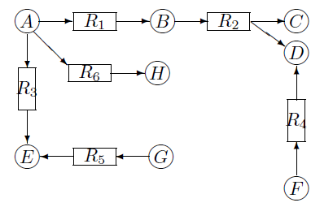
Impact degree by deletion of multiple reaction
Deletion of R1
Deletion of R4
Multiple deletion of (R1,R4)
Newly inactivated

Slide 12
Relation between essential genes of KEIO collection
and top 14 reactions with high impact degree
Calculate the impact degrees of single knockout for all reactions
included in E. coli of KEGG database. 1088 reactions, 831 compounds
Impact
degree
Reaction Enzyme gene
28 R00416 2.7.7.23 b3730 Essential
R02060 5.4.2.10 b3176 Non-essential
R05332 2.3.1.157 b3730 Essential
17 R04325 2.1.2.2 b1849,b2550 Non-essential
15 R04966 1.3.1.9 b1288 Essential
R04724 1.3.1.9 b1288 Essential
R03165 4.2.1.75 b3804 Essential
R00084 2.5.1.61 b3805 Essential
R00036 4.2.1.24 b0369 Essential
R02272 5.4.3.8 b0154 Essential
R05578 6.1.1.17 b2400 Essential
R04109 1.2.1.70 b1210 Essential
R01658 2.5.1.1 b0421 Essential
R02003 2.5.1.10 b0421 Essential
Avg. 2.364

Slide 13
Relation between essential genes of KEIO collection
and top 14 reactions with high impact degree
Calculate the impact degrees of single knockout for all reactions
included in E. coli of KEGG database. 1088 reactions, 831 compounds
Impact
degree
Reaction Enzyme gene
28 R00416 2.7.7.23 b3730 Essential
R02060 5.4.2.10 b3176 Essential in updated version
R05332 2.3.1.157 b3730 Essential
17 R04325 2.1.2.2 b1849,b2550 Non-essential
15 R04966 1.3.1.9 b1288 Essential
R04724 1.3.1.9 b1288 Essential
R03165 4.2.1.75 b3804 Essential
R00084 2.5.1.61 b3805 Essential
R00036 4.2.1.24 b0369 Essential
R02272 5.4.3.8 b0154 Essential
R05578 6.1.1.17 b2400 Essential
R04109 1.2.1.70 b1210 Essential
R01658 2.5.1.1 b0421 Essential
R02003 2.5.1.10 b0421 Essential
Avg. 2.364

Slide 14
Relation between essential genes of KEIO collection
and top 14 reactions with high impact degree
12 of the 14 genes are included in the list of essential genes of KEIO collection .
  13 of the 14 are essential in the updated version of KEIO collection. (Yamamoto et al. 2009)
However, most genes with high impact degree are located outside central metabolism, consisting of Glycolysis, Gluconeogenesis, Citrate cycle and Pentose phosphate pathway.
Since the central metabolism is of No.1 interest of most researchers, it is necessary to develop a mathematical model elucidating the relation between knockouts and essential genes.

Slide 15
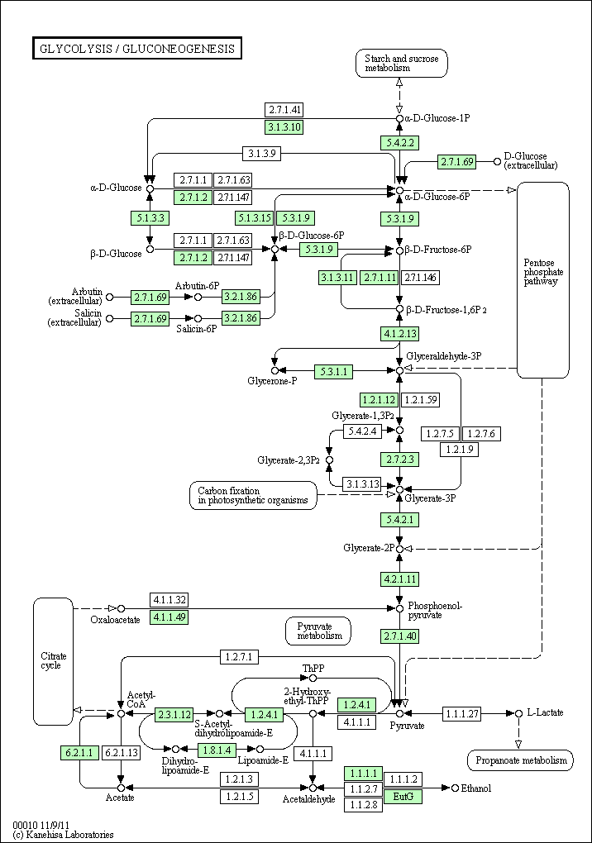
Should take account of
alternative pathways,
flux balance,
capability of producing important compounds,
chemical structure of each compound,
error of experiments etc.

Slide 16
Summary
Introduced mathematical model of metabolic network
  Flux balance model, Boolean model
  Impact degree model
    Combination of flux balance model and Boolean model
    Focusing on steady state
    #reactions(genes) impacted by knockout(s)
Applied to data of KEGG E. coli , 12 (13 in updated version) of the 14 genes with the highest impact degrees are included in the list of essential genes of KEIO collection .
  Good prediction outside central metabolism, but not good in central metabolism.
  Necessary to develop a mathematical model elucidating relation between knockouts and cell growth rate.
Should take account of alternative pathways, flux balance, capability of producing important compounds, chemical structure of each compound, error of experiments etc.
Analyzing cell growth data of double knockouts is also ongoing.

