Slide 1
Identifying Candidate Pathways to Explain Phenotypes in Genome-Wide Mutant Screens
Mark Craven
Department of Biostatistics & Medical Informatics
University of Wisconsin-Madison
U.S.A.
joint work with: Deborah Chasman,
Paul Ahlquist, Brandi Gancarz, Linhui Hao

Slide 2
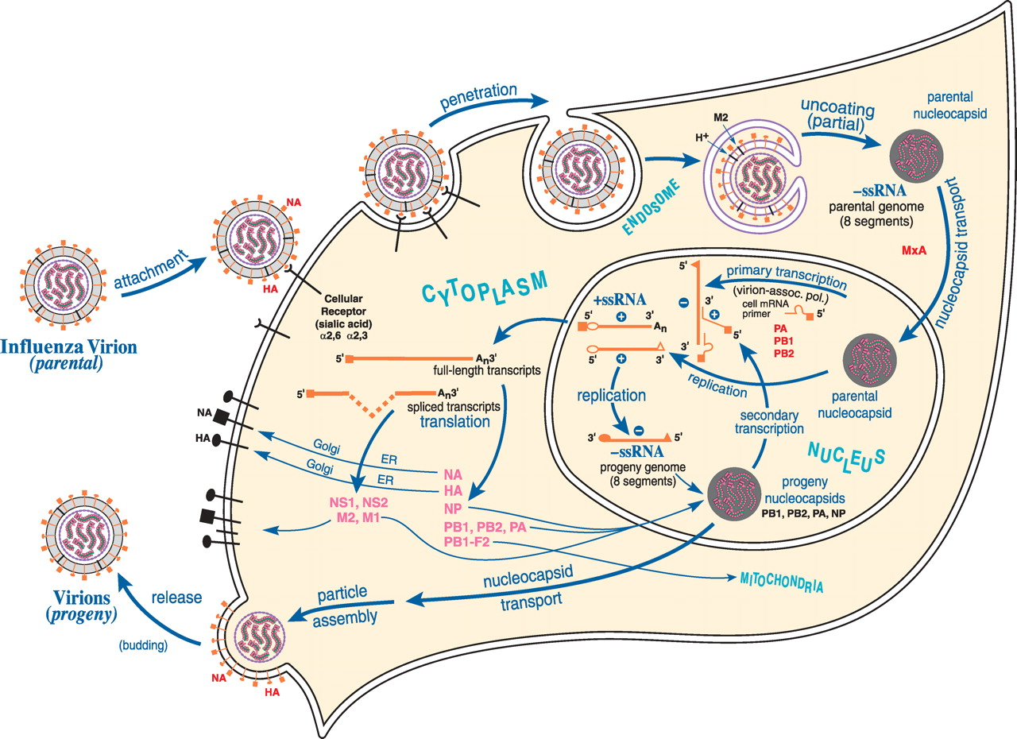
Viruses take advantage of host cell genes
Figure from: C. E. Samuel, Journal of Biological Chemistry 285, 2010.
Notes:
Schematic diagram of the influenza virus multiplication cycle. Enveloped influenza virion particles are depicted as spheres with two surface spike viral glycoproteins (HA and NA) that are major neutralization antigens of the virus. HA mediates binding to the cellular sialic acid receptor and membrane fusion. The eight negative-sense single-stranded RNA (ssRNA) genome segments are shown as wavy lines in nucleocapsid structures. Three viral proteins, PA, PB1, and PB2, constitute the trimeric viral RNA polymerase that, together with the nucleoprotein (NP), form the nucleocapsid ribonucleoproteins. Partial uncoating and release of the viral nucleocapsids into the cytoplasm follow penetration via receptor-mediated endocytosis and fusion of the envelope with the endosomal membrane. The viral envelope M2 protein is a hydrogen ion channel essential for virion uncoating. Parental nucleocapsids are imported into the nucleus, where virion-associated polymerase complexes catalyze primary transcription utilizing 5′-capped primers derived from cellular mRNAs. Influenza virus transcripts are processed and transported to the cytoplasm, where they are translated by the host cell's protein-synthesizing machinery. Newly synthesized progeny nucleocapsids may participate in further secondary transcription or may be exported to the cytoplasm, where particle assembly occurs at the plasma membrane with progeny virion release by budding. The NA glycoprotein possesses NA activity that cleaves sialic acid residues important in virion release and spread. Some strains of virus encode an alternative reading protein (PB1-F2) that has pro-apoptotic activity. The nonstructural protein NS1 antagonizes the antiviral innate immune response induced by interferon, and NS2 is involved in RNA export from the nucleus. The cellular MxA protein is an interferon-inducible GTPase that inhibits influenza virus multiplication. This figure was adapted from Samuel (6). ER, endoplasmic reticulum.

Slide 3
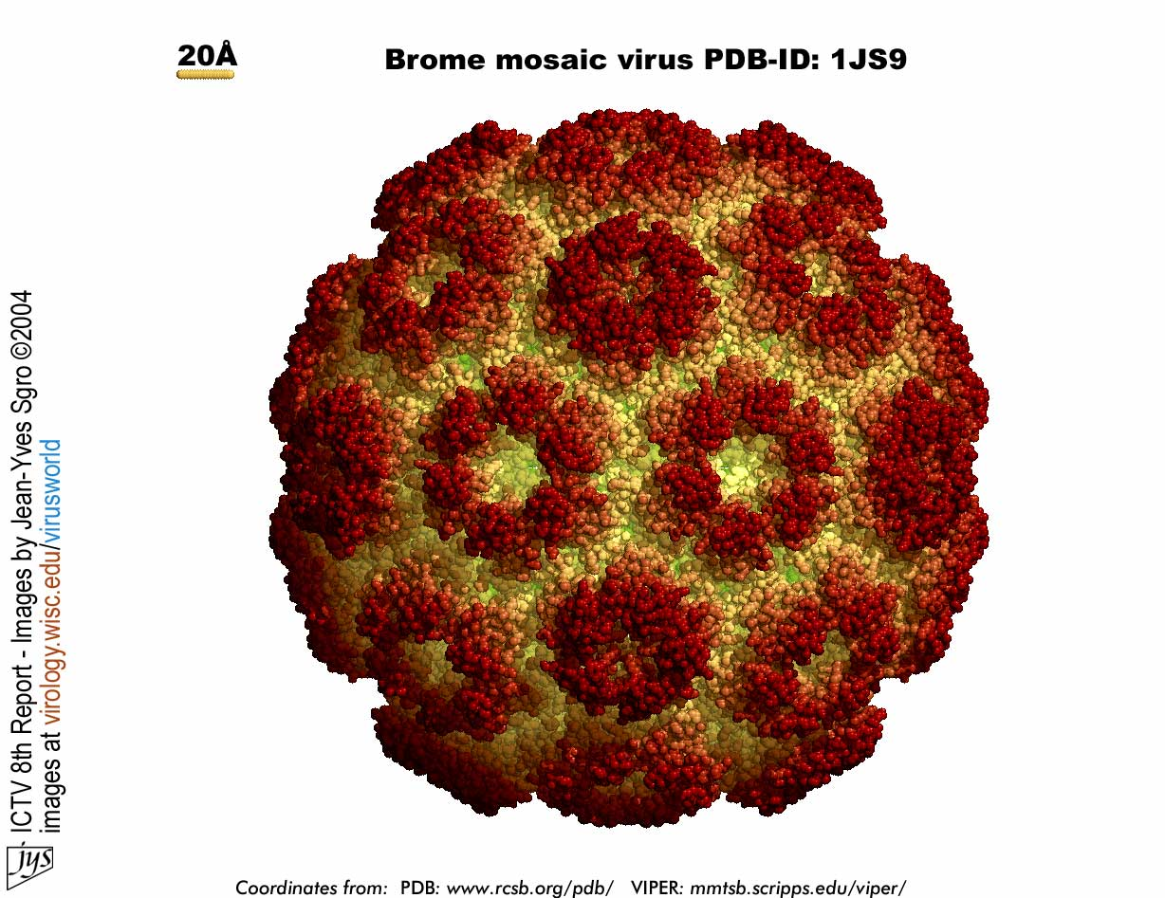
Genome-wide mutant screens
mutant
phenotype
MED1
YPR071W
NOT5
HOS1
SPE3
LTP1
MED1
YPR071W
NOT5
HOS1
SPE3
LTP1
MED1
YPR071W
NOT5
HOS1
SPE3
LTP1
MED1
YPR071W
NOT5
HOS1
SPE3
LTP1
Example: determining which host genes affect viral replication [Kushner et al., PNAS 2003; Gancarz et al., PLoS One 2011]
Notes:
systematically consider strains in which a single gene is knocked out; or suppressible
measure some phenotype of interest; in this case viral replication
say what color represents
this example focuses on mutants; but problem is conceptually similar with RNAi knockdowns

Slide 4
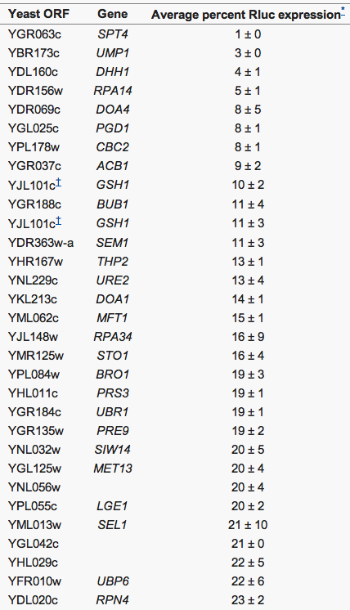
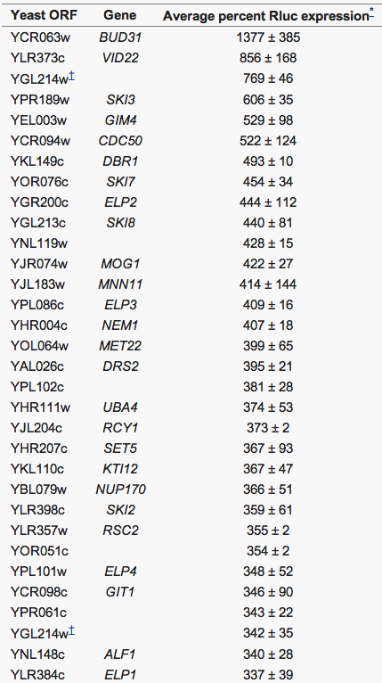
Genome-wide mutant screens
The output of such screens are sets of genes that either inhibit or stimulate viral processes
Notes:
this is from a yeast study with BMV (model SARS and hep C)
a big pile of genes (typically several hundred)
question: what are the pathways involved?
what are the dependencies among these measurements? What are the causal influences?
Different from other studies where variables correspond to expression levels of each gene: many measurements for each variable. Here we have many interventions; but only measure one variable.

Slide 5
Characterizing virus-host interactions
Some interactions are deemed not consistent with the measurements
given such interaction data, we want to
identify pathways that provide consistent explanations for the genome-wide measurements
predict the interfaces to the virus
Directions and signs of interactions are specified
before inference
after inference
Interfaces to the virus are hypothesized
Notes:
what happens on the right
- directions and signs of interfaces specified
- some interactions deemed not consistent
- interface to the virus added
mention that this is obviously simplified
actively developing two approaches for this type of inference

Slide 6
Integer programming approach
Collect candidate pathways for each “hit”
Use IP to identify a globally consistent subnetwork

Slide 7
Collecting candidate pathways for a hit
generate candidate pathways, up to a specified length, that link a hit to the virus

Slide 8
Variables in integer programming approach
Variable | Description
x_{e} | is edge e active?
s_{e} | sign of edge e (up- or down-regulating)
d_{e} | direction of edge e
t_{g} | phenotype (effect) of knocking out gene g
σ_{p} | is pathway p active?
Notes:
One approach based on Markov networks; the other on integer programming
Set up a large collection of variables (mostly binary); try to figure out what values to set to them
here I’m using graph terminology (edge == interaction)
pathways: directed paths from hits to the virus

Slide 9
Constraints in integer programming approach
all significant measurements (hits) are explained by at least one pathway
Notes:
every “hit” should be use in at least one pathway
for each pathway, either it’s not used, or it’s consistent
consistent means: for each edge: edge is active, direction is set consistent with pathway, sign of edge agrees with signs of effects on either end of edge

Slide 10
Constraints in integer programming approach
all active pathways are consistent, with edges directed toward the interface
Notes:
every “hit” should be use in at least one pathway
for each pathway, either it’s not used, or it’s consistent
consistent means: for each edge: edge is active, direction is set consistent with pathway, sign of edge agrees with signs of effects on either end of edge

Slide 11
Current objective function in integer programming approach
minimize the number of interfaces
Notes:
sum over interfaces, for each: consider pathways that use it; is there a pathway that uses this candidate interface

Slide 12
before inference
after inference

Slide 13
How to evaluate the IP approach?
see if we can correctly predict it using inferred networks
hold a measurement aside
?

Slide 14
Baseline predictors
neighbor voting
further neighbor voting
?
?
2 neighbors vote
2 neighbors vote
1 neighbor votes
3 neighbors vote
➔ predict
➔ predict

Slide 15
Baseline predictors
This gene votes because it has a repressing interaction with query gene
consistency neighbor voting
?
2 neighbors vote
1 neighbor votes
➔ predict

Slide 16
Markov network approach
variables are the same as in the IP
potential functions represent
the constraints
uncertainty associated with specific interactions
the preference for a small number of interfaces
inference done using Gibbs sampling

Slide 17
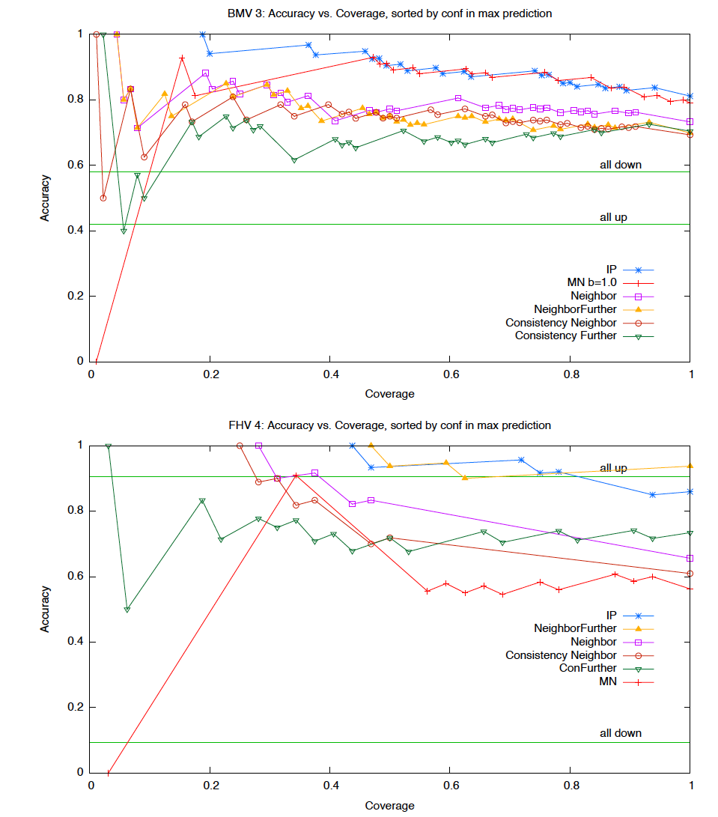
Predictive Accuracy (BMV)

Slide 18
Predictive Accuracy (FHV)

Slide 19
Future work
taking into account additional sources of information
quantitative values from assays
genetic interactions
interactions automatically extracted from the scientific literature
adapting approach to RNAi screens in mammalian cells
more genes
lower density of known interactions
more uncertainty in measurements
devising methods that use these models to determine which follow-up experiments would be most informative

