Slide 1
Using text extraction and reasoning to construct pharmaco-kinetic pathways and further reason with them to discover drug-drug interactions
Chitta Baral
Professor
Notes:
Text Mining and Automated Reasoning in Molecular Biology and Pharmacology

Slide 2
Our goal
Use AI techniques, in particular text mining and automated reasoning, to help answer several important questions in Molecular Biology and Pharmacology
Other related AI techniques
Natural Language Processing
Machine Learning
Knowledge Representation

Slide 3
Questions of our interest – at a high level
Explain (a set of) observations; make a diagnosis based on observations
Predict the impact of particular interventions
Design a drug therapy.
Generate hypothesis regarding hitherto unknown aspects of a bio-process.
Notes:
Explaining/Diagnosis – Use examples from the drug metabolism book.

Slide 4
Explaining observations
A phenotypical observation OR
an observation that a particular protein or chemical has abnormally high concentration
What is wrong? What is out of the ordinary?
The cause/explanation will give us approaches to fix the problem.
How deep should the explanations go?
How do we compare explanations?
Observation/History
64 old obese male prescribed with simvastatin 10 mg daily.
Next 3 months lack of clinical response led to 5-fold increase of dosage.
Admitted to hospital with Rhabdomyolysis.
Analysis
Patient was self administering St. John’s wort extract which he discontinued 10 days before the manifestation of toxicity.
Notes:
Initially while the patient was taking St. John’s wort the drug was cleared at a higher rate than normal. The doctor was not aware that the patient was taking St. John’s wort extract. The patient stopped taking thus reducing the clearance leading to accumulation of the drug.

Slide 5
Prediction
Impact of particular perturbations
say caused by a drug that introduces certain proteins to the cell membrane or into the cell
Do the perturbations have the desired impact?
Do they mess up something else?
side effects!

Slide 6
Designing drugs & therapies
What perturbations (when and where) need to be made so as to make the cells/tissues/system behave in a particular way?
In case of cancer: prevent proliferation, induce apoptosis, prevent migration, etc.
Notes:
Some one asked the question to Uri Alon in the morning about cancer.

Slide 7
But our knowledge is incomplete?
What kind of useful reasoning can we do with incomplete knowledge?
Make efforts to add to the knowledge
Hypothesis formation
Formulate hypothesis that would explain certain otherwise unexplainable observations
Selectively test some of them.

Slide 8
Pathway construction and interaction questions
Given a handle (could be a process and a gene name; a drug; etc.) synthesizing the partial pathway related to that handle.
Constructing the pharmacokinetic pathway of a drug.
Predicting and analyzing the interactions between various interventions
drugs; therapies; specific food; supplements; activities; etc.

Slide 9
Our approach
Do various kinds of reasoning with the following kind of knols and knol modules
Facts
Various kinds of interactions
General rules
e.g., Rules about pharmacokinetics
Rules needed for reasoning
General reasoning mechanisms
Explanation, diagnosis, prediction, planning and design
Domain Specific
Interaction analysis
Pathway Construction
Notes:
Knol – a unit of knowledge

Slide 10
Where do we get the “knols” from
Facts: Databases, Text
General Rules: Expert knowledge, Text
Reasoning Rules and Modules:
General
Given (already known); Develop them.
Domain Specific
Expert knowledge, Text

Slide 11
Text Mining: two aspects
Extract facts from text
Automatics Extraction
Collaborative development of databases
Obtain more general knowledge from the text
Notes:
Give examples.

Slide 12
Extracting Facts from Text
For example, some of the azole antifungals are inhibitors of both P450 enzymes and P-glycoprotein (Nivoix et al., 2008), whereas rifampicin is an inducer of both CYP3A4 and P-glycoprotein (Katragadda et al., 2005).
Notes:
[1] Boobis, A. et al. Drug Interactions. Drug Metabolism Reviews, 2009; 41(3): 486-527.

Slide 13
Extracting more general knowledge from text
While the importance of metabolism in many drug-drug interactions is beyond question, it has become increasingly apparent in recent years that inducers and inhibitors of some of the enzymes of drug metabolism can also affect drug transporter proteins.
For example, some of the azole antifungals are inhibitors of both P450 enzymes and P-glycoprotein (Nivoix et al., 2008), whereas rifampicin is an inducer of both CYP3A4 and P-glycoprotein (Katragadda et al., 2005). (page 2)
Hence, interaction can sometimes involve drug-metabolizing enzymes, drug transporters, or both.
Notes:
[1] Boobis, A. et al. Drug Interactions. Drug Metabolism Reviews, 2009; 41(3): 486-527.

Slide 14
Outline of the rest
Extraction of facts
Extracting Facts from text: protein-protein interactions
SNPshot of PubMed
Generalizing text extraction: querying parse trees
Reasoning Examples
Building pathways
Studying drug-drug interactions
Looking beyond automatic extraction and manual curation
Future work: Extraction of richer knowledge
Conclusion

Slide 15
Extracting facts from text: protein-protein interactions

Slide 16
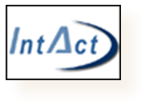

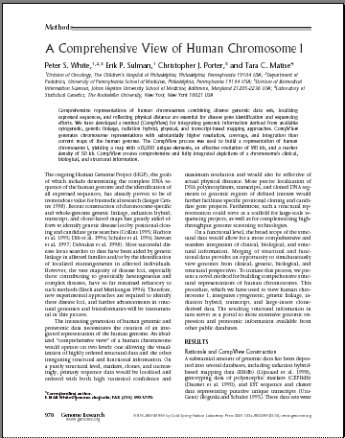
Yappie – Work flow
Gold standard
Protein pairs
Training docs
Example sentences
Initial phrases
Annotation: POS/NE
Initial patterns
Predicted interactions
Clustering & MSA
Matching
Consensus patterns
New text

Slide 17
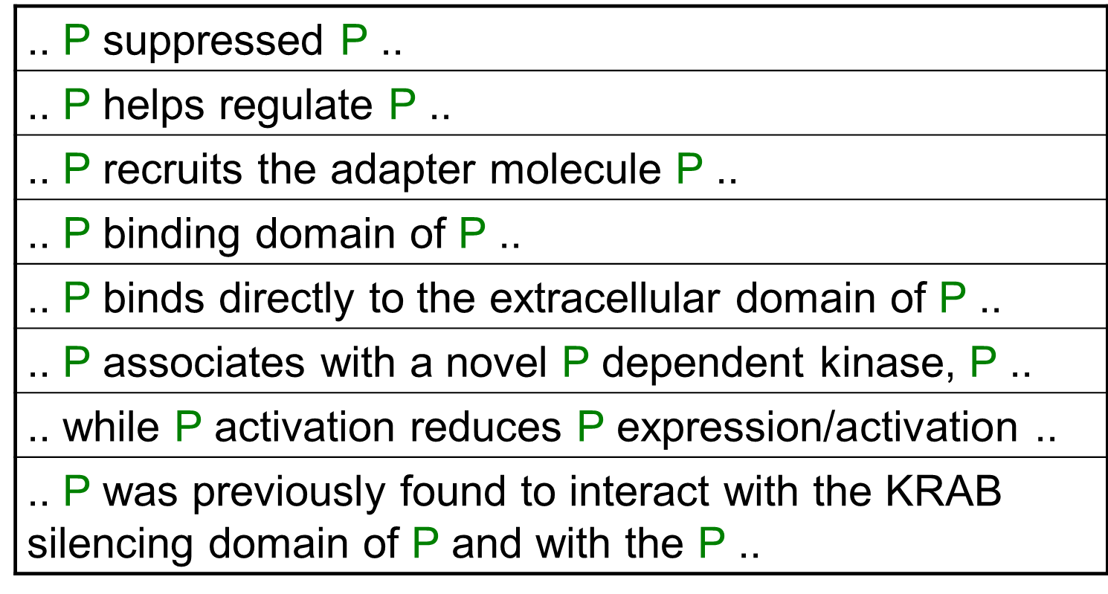
Yappie – Initial phrases
>120,000 snippets that discuss PPI, such as

Slide 18
Yappie – Multiple phrase alignment
Initial phrases:
protein | strongly | binds | to |  | protein
protein |  | interacts | with | the | protein
protein | never | binds | to |  | protein
protein |  | regulates |  | the | protein
protein |  | inhibits |  | a | protein
Consensus pattern:
PROTEIN | {strongly,never} | {binds, .., ..} | {to, with} | {the, a} | PROTEIN
would exactly match the sentence (part):
protein |  | binds | to | the | protein

Slide 19
Performance: PPI extraction
#4 system in BioCreative 2 for protein-protein interactions (2007)
f-measure of 24%, respectively (1st: 30%)
20 participants
#1 system for PPIs in BioCreative II.5 (2009)
30% f-score (2nd: 23%)
15 participants
>100 submissions overall (multiple configurations per participating team allowed
Main Person leading this at ASU: Joerg Hakenberg (Now at Roche)

Slide 20
BioCreative II.5 challenge
Participated 2 of 3 tasks
INT: Interactor normalization task (1st )
IPT: Interaction pair task (1st )
http://www.biocreative.org/news/chapter/biocreative-ii5/
Main person in our group on this: Joerg Hakenberg
Notes:
BioCreative (Critical Assessment for Information Extraction in Biology) is the main challenge evaluation in the area of biological text mining, focused on assessment of text mining applied to problems from real biological applications. To date, there have been three BioCreative evaluations; the biological task for the first BioCreative (2003-2004) focused on the automatic extraction and assignment of Gene Ontology (GO) annotations to human proteins based on information from full text articles. The biological task for both BioCreative II (2006-2007) and BioCreative II.5 (2009) focused on the identification of protein-protein interactions, in support for the curation of the IntAct and the MINT protein interaction databases. This series of evaluations has advanced the state of the art in text mining applied to biological problems.

Slide 21
Outline of the rest
Extraction of facts
Extracting Facts from text: protein-protein interactions
SNPshot of PubMed
Generalizing text extraction: querying parse trees
Reasoning
Examples of reasoning: building pathways
More reasoning (Ongoing work): Studying drug-drug interactions
Looking beyond automatic extraction and manual curation
Future work: Extraction of richer knowledge
Conclusion

Slide 22
SNPshot of PubMed

Slide 23


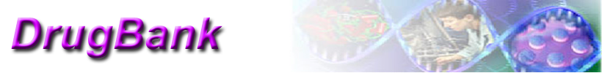
SNPshot: Aim
collect information on genes regarding
genetic variants / mutations / alleles,
associations with diseases,
drug interactions (transport, metabolism; activation, inhibition),
allele frequencies and populations
large-scale, fully automated
from Medline abstracts
link to evidence and cross-link to other databases for validation and further information
Notes:
cf. PharmGKB, DrugBank, PharmGED, TTD, …

Slide 24

Entities & relations
genes & proteins
drugs
diseases
genetic variants / mutations
SNPs / alleles / haplotypes
populations & frequencies
MutationFinder [CBR+07], 700 regular expressions; added 100 more
BANNER [LG08@PSB]

Slide 25
Normalization
map genes, drugs, diseases to database identifiers (EntrezGene, Uniprot; PharmGKB, DrugBank; UMLS)
canonical form for variants (HGVS: c.76A>T)
map SNPs to RefSNP/dbSNP
populations to canonical form
plain dictionary matching for drugs & diseases
GNAT for genes & proteins [HPL+08]
heuristics for all others

Slide 26

Data sets
PubMed abstracts
PharmGKB: 3614 referenced PubMed citations
40 VIP PGx genes from PharmGKB
expanded using PubMed’s “Related Articles” functionality ➠ 26,000 additional abstracts
PubMed query ➠ 30,000 abstracts
around 58,000 abstracts

Slide 27
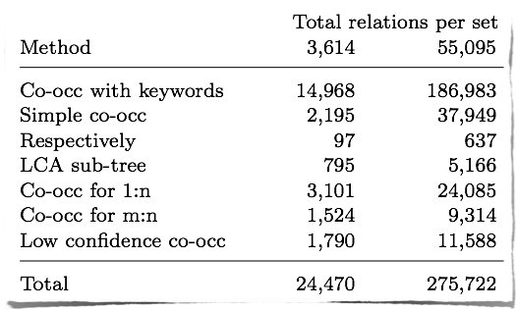
Relationship extraction
mostly simple heuristics
sentence-level co-occurrence + keywords (for different kinds of relations: [CKY+08] )

Slide 28
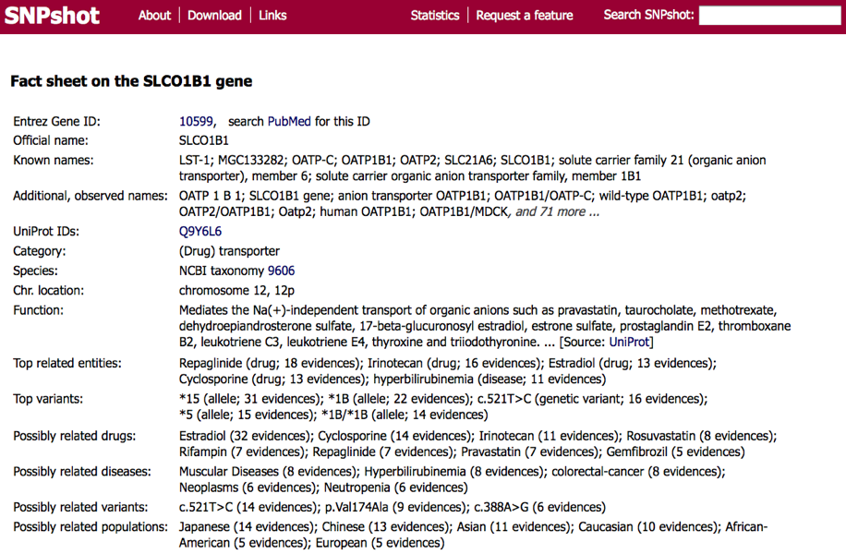
Summary for a gene ..

Slide 29
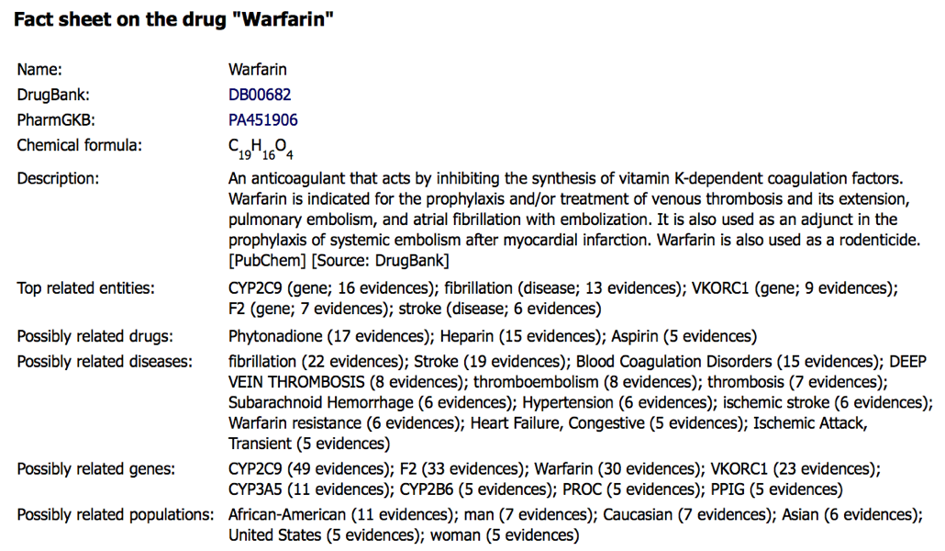
... and a drug

Slide 30
Evaluation
comparison to PharmGKB and DrugBank
coverage / recall
relation not in PGKB ➠ wrong or just not in PGKB
manual validation of predictions
precision & recall
BANNER: 86% F-score on BioCreative 2 GM
GNAT: 85% F-score on BioCreative 2 GN (human)
prior evaluations: [CTK+06@PSB] and others
high confidence in co-occurrence for some relations (gene-disease = 94%, gene-drug, drug-disease) but not others (protein-protein < 50%)

Slide 31
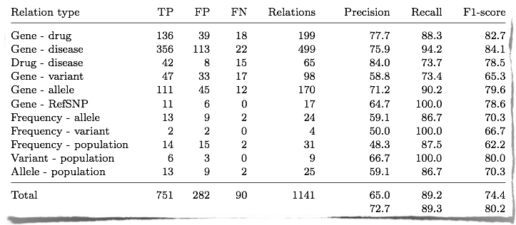
Results ...
… from manual evaluation
1141 relations ➠ check each evidence sentence for TP/FP/FN

Slide 32
Outline of the rest
Extraction of facts
Extracting Facts from text: protein-protein interactions
SNPshot of PubMed
Generalizing text extraction: querying parse trees
Reasoning
Examples of reasoning: building pathways
More reasoning (Ongoing work): Studying drug-drug interactions
Looking beyond automatic extraction and manual curation
Future work: Extraction of richer knowledge
Conclusion

Slide 33
Generalizing text extraction: Querying Parse Trees

Slide 34
Motivation
Traditional information extraction technique works as a pipeline
Perform grammar parsing, named entity identifier, named entity recognizer, normalization, extraction
Information extraction is seen as a one-time process
Common issues in the development of extraction system
What if we change our extraction goals?
e.g. extract gene-disease associations rather than protein-protein interactions
What if we have an improved NER system?
Which of the extraction patterns work well?

Slide 35
Motivation
Information extraction should not be seen as a pipeline or one-time process
With the pipeline approach, need to re-extract from the entire text collection
Computationally expensive!
But change of extraction goals or improvement of components does not affect the entire text collection
if we extract gene-disease associations, only need to extract from sentences that have gene and disease mentions
if we deploy a new NER, only sentences that are newly tagged are needed to perform re-extraction

Slide 36
What’s needed for extraction?
To minimize reprocessing, we need to store parse trees and semantic information
a database is ideal to store information that we need to perform extraction
Extraction should be seen as generic
Can we use database queries as information extraction?
Hard to express syntactic patterns with SQL
We need a new query language for extraction, called parse tree query language (PTQL)
Notes:
Traditional IE approach uses database as a storage of extracted facts, not the intermediate processed information.
we should be able to extract what we want, provided that we have the appropriate information
It’s easy to identify which the impact of each patterns when we run them as database queries

Slide 37
Parse trees
Stores dependency linkages and constituent trees
Linkage: shows the dependencies between words in a sentence
S: connects subject-noun
E: verb-modifying adverbs
O: transitive verbs to direct or indirect objects
+---------Ss--------+
| +----E-----+---O----+
| | | |
RADB53 positively regulates.v DBF4 .
S
Constituent trees are represented “vertically”
Linkages are represented “horizontally”
VP
NP
ADVP
NP
E
N
ADV
V
N
tag=P
value=RAD53
O
tag=P
value=DBF4
S
tag=I
value=regulates
value=positively

Slide 38
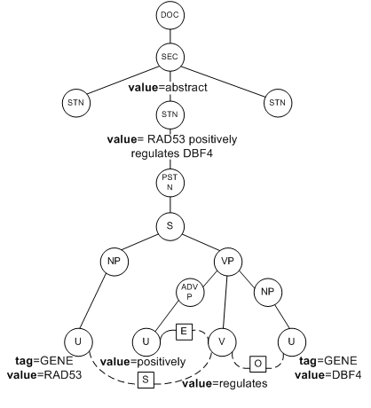
Parse Tree Database
Represents a document with its sentences and parse trees in a hierarchy
Uses a labeling scheme
Certain important properties:
Given a parse tree, for any pair of nodes q and p,
q is a child of p iff q.pid = p.id
q is a descendant of p iff q.left ≥ p.left, q.right ≤ p.right and q.depth > p.depth
q immediately follows p iff the left most child of q immediately follows the right most child of p, i.e., q.left = p.right
q follows p iff q.left ≥ p.right

Slide 39
PTQL query syntax
A PTQL query has 4 components in this format
tree pattern : link condition : proximity condition : return expression
Tree pattern
X{...Y...}: Y is a node in the subtree with X as the root
/: parent/child relation in the constituent tree
//: ancestor/descendant relation in the constituent tree
Example: //S{//N[tag=‘P’]->/VP{/V[tag=‘I’]->//N[tag=‘P’]}}
S
VP
N
V
N
tag=P
S
tag=I
O
tag=P

Slide 40
PTQL query syntax
To describe horizontal order of nodes:
x -> y: x immediately follows y
x => y: x follows y
Tree pattern : Link condition : : Return expression
//S{//N[tag=‘P’](x)->/VP{/V[tag=‘I’](y)-> //N[tag=‘P’](z)}} : x !S y and y !O z :: x.value, y.value, z.value
S
VP
x
z
y
N
V
N
tag=P
S
tag=I
O
tag=P

Slide 41
Other applications of PTQL
Feature extraction
Find all MeSH terms and their frequencies among documents that contain recognized gene names.
//DOC(x) { //?[tag=’GENE’] } : : : count(x.mesh), x.mesh
Normalize gene names
Find articles x of some author in which gene y is mentioned.
//DOC(x)[author='John Smith']{//?[tag='GENE'](y)}::: distinct x.value, y.value
Normalize gene names to species
Find gene-species relations based on some grammatical patterns, such as gene and species occurring in the same noun phrase.
//S{//NP{//N[value='human']=>//?[tag='GENE'](x)}} ::: x.value
Boosting recall for gene name recognizer
Suppose “p53” has been tagged as a gene name in some documents, find “p53” such that “p53” is not tagged as a gene name.
//DOC(x){//STN(y){//?[tag!='GENE' and value='p53']}}::: x.value, y.value

Slide 42
Outline of the rest
Extraction of facts
Extracting Facts from text: protein-protein interactions
SNPshot of PubMed
Generalizing text extraction: querying parse trees
Reasoning
Examples of reasoning: building pathways
More reasoning (Ongoing work): Studying drug-drug interactions
Looking beyond automatic extraction and manual curation
Future work: Extraction of richer knowledge
Conclusion

Slide 43
Building pathways

Slide 44
Building pathways
An important part of understanding or reverse-engineering biological phenomena (disease, phenotype, etc.)
Connecting the dots !!!
Building pathways involves
Connecting the dots, where the dots are
Biological data (such as interactions)
But an equally important aspect is
Biological Knowledge and
Reasoning with that knowledge
Notes:
Next: We start with pharmakoinetic pathway
Mainly because of some general knowledge that is very useful in constructing pathways

Slide 45
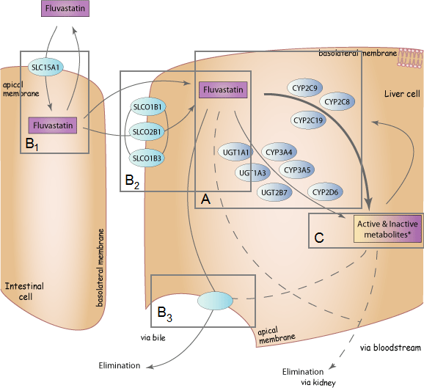
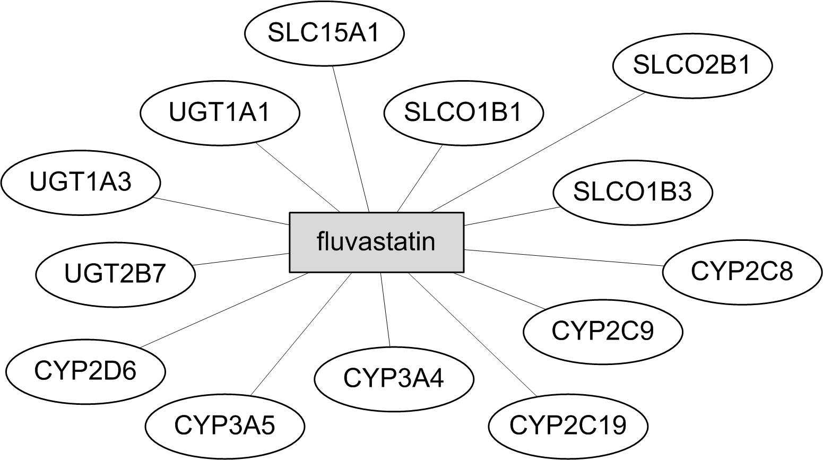
Network vs pathway
Pharmacokinetics represented as a network
Pharmacokinetics represented as a pathway (from PharmGKB)
Notes:
Pharmacokinetics is concerned with the relationships between various processes during the course of the drug consumption in the body.
If this is represented as a network, it does not provide any information about the ordering of the interactions, which is important for the understanding of pharmacokinetics
Fetching the facts and interactions alone leads to the formation of a network of interactions, but the resulting network lacks the information that describes which of the interactions appear ahead of the others.
On the other hand, the pathway representation of fluvastatin shows the ordering of the interactions.
The key idea for pathway synthesis is not only to collect the interactions but to order them in a biologically meaningful way

Slide 46
Pharmacokinetics
metabolism of the drug by the enzymes
drug transporters distribute the drug for absorption in intestine
drug transporters distribute the drug for metabolism in liver
drug transporters distribute the drug for elimination in liver
the drug is metabolized to metabolites by the enzymes
Source: PharmGKB
Notes:
Region A: metabolism of the drug by the enzymes; Region B: in B1, for metabolism in B2 and for elimination in B3; Region C: the drug is metabolized to metabolites by the enzymes.

Slide 47
Pathway synthesis needs
Using pharmacokinetic pathway as example
Type of interactions
Knowing that drug A interacts with protein B is not sufficient
We need:
Is A distributed by transporter B?
Is A metabolized by enzyme B?
Ordering of interactions
Knowing that drug A interacts with transporter B, and A with enzyme C is not sufficient
We need: knowledge that captures the fact that A has to be distributed by B before A is metabolized by C
Notes:
What do we need in order to create pathways?
We need to find out interactions between entities such as drugs and enzymes. More importantly we need to identify the types of the interactions, as each kind of interactions has different roles in the pathways
Knowing the interactions is not enough. We need to order the interactions by capturing the pre- and post conditions of the interactions. For instance, drug A can only be metabolized by enzyme C if A has been distributed to a certain location in the liver by transporter B

Slide 48
Our approach
Part 1: Data acquisition
Fact and interaction extraction from knowledge bases and text
Knowledge bases: DrugBank, PharmGKB (drug-gene relations only), Gene Ontology annotations
Text: entire collection of Medline abstracts
Part 2: Automated reasoning using Knowledge
Inferences of pathways through reasoning with the extracted interactions
Logic rules to capture biological knowledge of pharmacokinetic pathways and order the interactions
Notes:
With the diverse extraction needs in the synthesis of pharmacokinetic pathways, it is not feasible to develop individual extraction systems for each specific extraction goal when lexical and syntactic clues are used for extraction.
This implies the need of a flexible system that is designed for extraction of various interactions and their types.
Facts such as location of drug metabolism is rarely mentioned explicitly in literature.
We rely on manual annotation from DrugBank and Gene Ontology for such facts.
Gene names from the extracted interactions are normalized into their standardized names to avoid name ambiguity
As the interactions themselves do not reveal any kind of ordering, the goal is to represent the fundamental behavior and properties of pharmacokinetics so that the
representation can be utilized to assign ordering of the interactions through reasoning.

Slide 49
Data acquisition from curated sources
DrugBank
whether a drug is taken orally or intravenously
where metabolism of a drug takes place
PharmGKB
interactions between drug and proteins
Gene Ontology (GO) annotations
determine if a protein is an enzyme or a drug transporter

Slide 50
Data acquisition with text extraction
Extraction of various interactions from Medline abstracts
Example:
Fluvastatin is metabolized by CYP2C9, while simvastatin, lovastatin and atorvastatin are metabolized by CYP3A4.
Sample extracted facts from above sentence:
metabolizes(CYP2C9, fluvastatin) is correct
metabolizes(CYP3A4, fluvastatin) is incorrect
Intuition: extraction technique needs to go beyond coccurrences

Slide 51
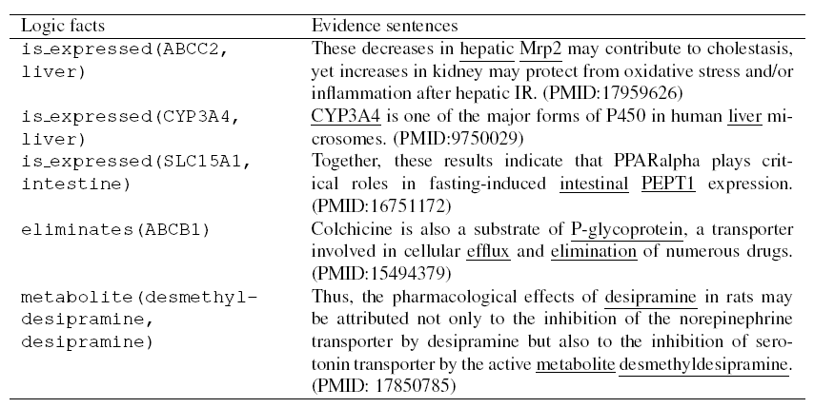
Sample extracted facts

Slide 52
Automated reasoning
Get necessary facts and interactions from curated sources and text extraction
Question: how to assign ordering to the interactions to construct pathways?
Idea:
encode knowledge (rules) for pharmacokinetics
pre- and post-conditions of interactions
Similar to pre and post conditions of actions in AI planning and scheduling scenarios
arrange the interactions with automated reasoning
assigning time points to interactions
Notes:
Fetching the facts and interactions alone leads to the formation of a network of interactions, but the resulting network lacks the information that describes which of the interactions appear ahead of the others.

Slide 53
Logic rules
AnsProlog: for reasoning and representing knowledge
Pre- and post-conditions of interactions
Timepoints for the logical ordering of interactions
Sample logic rule describing that the action “metabolize” has to happen before the action “eliminate”
o(eliminates(DT,Dr),Loc, T) :-
h(metabolized(Dr, Loc),T),
extr_elim(DT,Dr), extr_metabolism(Dr, Loc).
from extraction
Notes:
The core idea of the representation of pharmacokinetics is to encode the pre- and post-conditions of interactions.
We used a popularly used knowledge representation language called Answer Set Prolog (AnsProlog in short) to represent pharmacokinetics.
The facts extracted from text and manual annotation (preceded by “extr”) are translated into logic facts
The action “eliminates” means that a drug transporter DT is responsible for the elimination of drug Dr in organ Loc. Variable T is a logical timepoint that indicates the ordering of the interactions. An action at timepoint 1 means that its action take place before another action at timepoint 2.
This particular rule states that the pre-condition of this action (right hand side of “:-”) is that “metabolize” action has to precede “elliminates”
From the extracted facts, we realize which DT is responsible for elimination of Dr, and where metabolism of Dr takes place.
Once we have sufficient knowledge which drug transporter is responsible for the elimination of this particular drug, we know that this action has to follow “metabolize”.
This is how we order the interactions by encoding pre- and post-conditions of the major actions involved in pharmacokinetics

Slide 54
Sample logic rules about pharmacokinetics
Direct effect of an action (post-condition)
h(metabolized(D, Loc),T+1) :- o(metabolizes(EN, D), Loc, T), not -h(metabolized(D, Loc),T).
Indirect effect of an action (static causal law)
-h(is_present(D, Loc), T+1) :- h(eliminated(D, Loc),T), metabolism(D, Loc).
Constraint – all interactions in intestine must appear before the interactions in liver
:- o(ACT, liver, T), o(ACT1, intestine, T1),
T <= T1.
Notes:
The action “distributes” can be executed only if (i) drug transporter DT is known to distribute D; (ii) the drug D is present in organ Loc at timepoint T; (iii) DT is known to be expressed in organ Loc; (iv) DT is known to be expressed in the membrane;
The action “metabolizes” indicates that enzyme EN metabolizes drug D at timepoint T, and drug D becomes metabolized in organ Loc at timepoint T+1.
When drug D is distributed for elimination in organ Loc at timepoint T, in which metabolism of D occurs in Loc, D is no longer present in Loc in the next timepoint.
Commonsense law of inertia

Slide 55
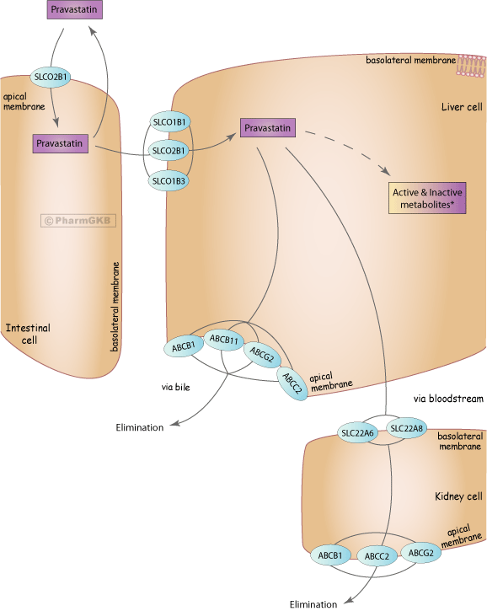
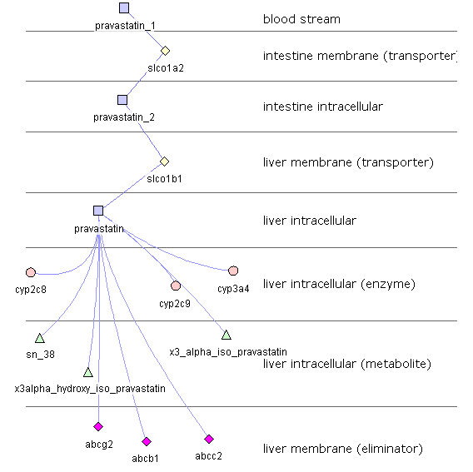
System output
Input: drug name
Output: models describing each of the pathway steps, represented in Cytoscape Cerebral graphs
Notes:
Given a drug name as input, our system generates pharmacokinetic pathway of the drug as output.
Our system provides the output in the form of logic facts, as well as GPML files that can be visualized in Cytoscape with the Cerebral plug-in, which takes advantages of the protein cellular locations in generating the layout of the pathways.

Slide 56
Limitations
Our synthesized pathways do not capture
which enzymes are responsible for the production of a particular drug metabolite
Drug-enzyme-metabolite relations can rarely be found within individual sentences
transformation of a metabolite to another metabolite through enzymes
as suggested by the pathways for phenytoin and tamoxifen
close-loop interactions
Notes:
[Leaman08] R. Leaman, G. Gonzalez. BANNER: An executable survey of advances in biomedical named entity recognition. In PSB’08.
[Gelfond88] M. Gelfond and V. Lifschitz. The Stable Model Semantics for Logic Programs. International Symposium on Logic Programming (1988).
[Hakenberg08] J. Hakenberg, C. Plake, R. Leaman, et al. Inter-species normalization of gene mentions with GNAT. In ECCB’08.
[Tari09] L. Tari, J. Hakenberg, G. Gonzalez, C. Baral. Querying parse tree database of Medline text to synthesize user-specific bionetworks. In PSB’09.

Slide 57
Outline of the rest
Extraction of facts
Extracting Facts from text: protein-protein interactions
SNPshot of PubMed
Generalizing text extraction: querying parse trees
Reasoning
Examples of reasoning: building pathways
More reasoning (Ongoing work): Studying drug-drug interactions
Looking beyond automatic extraction and manual curation
Future work: Extraction of richer knowledge
Conclusion

Slide 58
Studying drug-drug interactions

Slide 59
Importance of studying drug-drug interactions
Drug design: Early assessment of a new compound’s potential interactions with other drugs can avoid costly investment in the drug discovery process.
Drug prescription: For multi-drug prescription, pharmacokinetic interactions amongst co-administrated drugs may alter the bioavailability of the drugs that can lead to life-threatening side effects for the patients.

Slide 60
An Example
S-warfarin, predominantly responsible for the anticoagulation effect, is metabolized mostly by the CYP2C9 enzyme. [PMID: 19799531]
CYP2C9 is subject to induction by rifampin, phenobarbital, and dexamethasone. [PMID: 19515014]
metabolize
induce
Phenobarbital
Warfarin
Rifampin
CYP2C9
Dexamethasone

Slide 61
Example cont.
Consequence:
CYP2C9 enzyme activity is increased.
Rate of metabolism of warfarin by CYP2C9 is increased.
Bioavailability of warfarin is decreased.

Slide 62
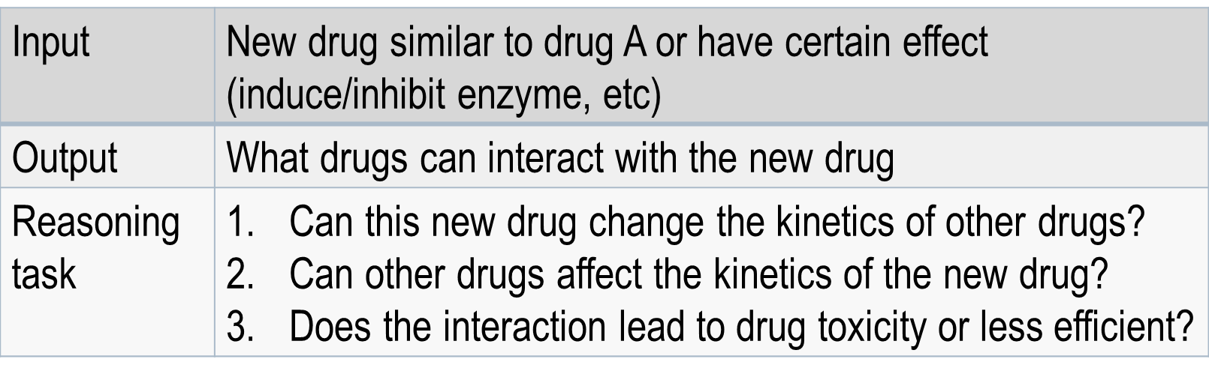
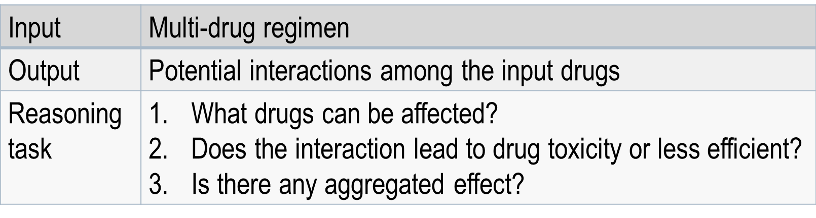
System Overview

Slide 63
Data Acquisition
Existing Knowledge base of drug-drug interactions:
PharmGKB
DrugBank
Pros: Accurate information about curated drugs.
Cons: Still remain largely incomplete.
We add:
Automated extraction via PTQL

Slide 64
Extracted Facts
 | <Entity - Entity> | Relation Keywords
1 | Drug – Protein | Induce / Inhibit Increase / Decrease
2 | Protein – Drug | Metabolize / Distribute / Eliminate
3 | Protein – Protein | Activate / Suppress Up-regulate / Down-regulate
4 | Protein – Role | Enzyme / Transporter / Eliminator / Transcription Factor
 | <Entity - Entity> | Relation Keywords <not> --- used to filter out false positives
1 | Drug – Protein | N_Induce / N_Inhibit N_Increase / N_Decrease
2 | Protein – Drug | N_Metabolize / N_Distribute / N_Eliminate
3 | Protein – Protein | N_Activate / N_Suppress N_Up-regulate / N_Down-regulate

Slide 65
Reasoning about Pairwise DDI
Knowledge encoding for enzyme-mediated DDI:
result(Dr1, increases, Dr2) :-
affects(Dr1, level(P, low)),
role(P, enzyme),
relation(P, metabolizes, Dr2).
result(Dr1, decreases, Dr2) :-
affects(Dr1, level(P, high)),
role(P, enzyme),
relation(P, metabolizes, Dr2).
For transporter, etc., the reasoning is similarly encoded.
Can be obtained from:
Drug-Protein relation from direct fact extraction.
Drug-Protein + Protein-Protein relation from fact extraction. (see next slide)

Slide 66
Reasoning about Pairwise DDI (cont.)
Knowledge encoding for Transcription Factor (TF)-mediated DDI:
affects(Dr, level(P, high)) :-
affects(Dr, level(TF, high)),
role(TF, tf),
relation(TF, upregulates, P).
affects(Dr, level(P, low)) :-
affects(Dr, level(TF, high)),
role(TF, tf),
relation(TF, downregulates, P).
Then affects(Dr, level(P, high/low)) will be used to reason for the transcription-factor mediated DDI (see previous slide)
Notes:
TF Transcription Factor

Slide 67
Outline of the rest
Extraction of facts
Extracting Facts from text: protein-protein interactions
SNPshot of PubMed
Generalizing text extraction: querying parse trees
Reasoning
Examples of reasoning: building pathways
More reasoning (Ongoing work): Studying drug-drug interactions
Looking beyond automatic extraction and manual curation
Extraction of richer knowledge
Conclusion

Slide 68
Extracting more general knowledge from text
While the importance of metabolism in many drug-drug interactions is beyond question, it has become increasingly apparent in recent years that inducers and inhibitors of some of the enzymes of drug metabolism can also affect drug transporter proteins.
For example, some of the azole antifungals are inhibitors of both P450 enzymes and P-glycoprotein (Nivoix et al., 2008), whereas rifampicin is an inducer of both CYP3A4 and P-glycoprotein (Katragadda et al., 2005). (page 2)
Hence, interaction can sometimes involve drug-metabolizing enzymes, drug transporters, or both.
Notes:
[1] Boobis, A. et al. Drug Interactions. Drug Metabolism Reviews, 2009; 41(3): 486-527.

Slide 69
The approach
CCG grammar as syntax and Lambda calculus formulas as semantics of words
After parsing, the application of lambda calculus expressions as dictated by the parsing gives the meaning of the sentence.
The meaning is a formula in a knowledge representation language.
Questions also get translated to logical formulas.
Grammar and Meaning of words can be learned from sample sentences and their meaning.

Slide 70
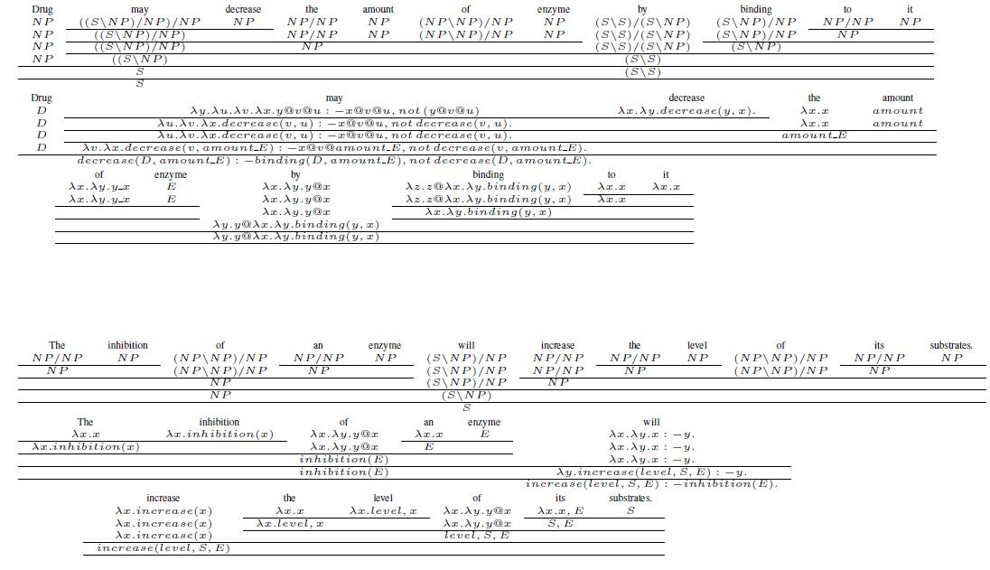
Using CCG and Lambda

Slide 71
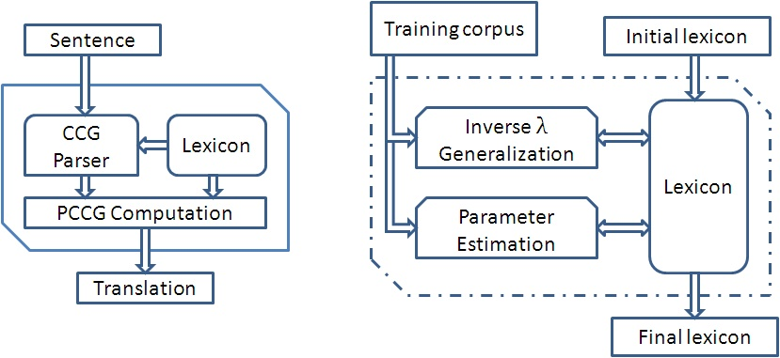
A learning based system to translate English to KR langauges

Slide 72
Recap
Overview of where AI (artificial intelligence) techniques can be useful in Molecular Biology & Pharmacology.
Extraction of facts
Extracting Facts from text: protein-protein interactions
SNPshot of PubMed
Generalizing text extraction: querying parse trees
Reasoning examples
Building pathways
Studying drug-drug interactions
Looking beyond automatic extraction and manual curation
Extraction of richer knowledge
Conclusion

Slide 73
Conclusion
AI techniques can be of big help in molecular biology and pharmacology
Especially: NLP, representation and reasoning
Use of machine learning in NLP
We are at a stage where we can envision
Translate natural language text to a formal logic
And reason with that logic

Slide 74
Acknowledgements
My students and post-doctoral researchers
Especially, Luis Tari, Joerg Hakenberg, Graciela Gonzalez, Bob Leaman, Vo Nguyen.
Funding agencies
NSF
Science Foundation of Arizona
ASU
IARPA; ONR

