Slide 1

Automating Biology using
Robot Scientists
Ross D. King
Department of Computer Science
Aberystwyth University
rdk@aber.ac.uk

Slide 2
Automating Biology

Slide 3
The Concept of a Robot Scientist
We have developed the first computer system that is capable of originating its own experiments, physically doing them, interpreting the results, and then repeating the cycle.
Background Knowledge
Analysis
Hypothesis Formation
Consistent
Hypotheses
Experiment
Results Interpretation
Final Theory
Experiment selection
Robot

Slide 4
Motivation: Philosophical
What is Science?
The question whether it is possible to automate the scientific discovery process seems to me central to understanding science.
There is a strong philosophical position which holds that we do not fully understand a phenomenon unless we can make a machine which reproduces it.
“What I cannot create, I do not understand” (Richard Feynman).

Slide 5
Motivation: AI
Science is an excellent test bed for AI
Science v Chess
  abstract world: 64 squares, 36 pieces.
  Computers play chess as well or better than the best humans, and computers can now make strikingly beautiful moves.
Science v General Intelligence
  Abstraction
  Nature is honest

Slide 6
Motivation: Technological
In many areas of science our ability to generate data is outstripping our ability to analyse it.
One scientific area where this is true is Systems Biology, where data is now being generated on an industrial scale.
The analysis of scientific data needs to become as industrialised as its generation.

Slide 7
Technological Advantages
Robot Scientists have the potential to increase the productivity of science
  by enabling the high-throughput testing of hypotheses.
Robot Scientists have the potential to improve the quality of science
  by enabling the description of experiments in greater detail and semantic clarity.

Slide 8
Scientific Discovery
Meta-Dendral: Analyis of mass-spectrometry data. Feigenbaum, Djerassi, Lederburg (1969).
Bacon: Rediscovering physics and chemistry. Langley, Bradshaw, Simon (1979).
Automated discovery in a chemistry laboratory. Zytkow, Zhu, Hussman (1990).

Slide 9
Robot Scientist Timeline
1999-2004 Initial Robot Scientist Project
  Limited Hardware
  Collaboration with Douglas Kell (Aber Biology), Steve Oliver (Manchester), Stephen Muggleton (Imperial)
  King et al. (2004) Nature, 427, 247-252
2004-2011 Adam Project
  Sophisticated Laboratory Automation
  Collaboration with Steve Oliver (Cambridge).
  King et al. (2009) Science, 324, 85-89
2008-2011 Eve Project

Slide 10
Adam

Slide 11
The Experimental Cycle
Background Knowledge
Hypothesis Formation
Analysis
Consistent
Hypotheses
Experiments(s)
Experiment(s) selection
Final Theory
Robot
Results
Interpretation

Slide 12
The Application Domain
Functional genomics
In yeast (S. cerevisiae) ~15% of the 6,000 genes still have no known function.
EUROFAN 2 made all viable single deletant strains.
Task to determine the “function” of a gene by growth experiments.

Slide 13
Logical Cell Model
We have developed a logical formalism for modelling metabolic pathways (encoded in Prolog). This is essentially a directed labeled hyper-graph: with metabolites as nodes and enzymes as arcs.
If a path can be found from cell inputs (metabolites in the growth medium) to all the cell outputs (essential compounds) then the cell can grow.

Slide 14
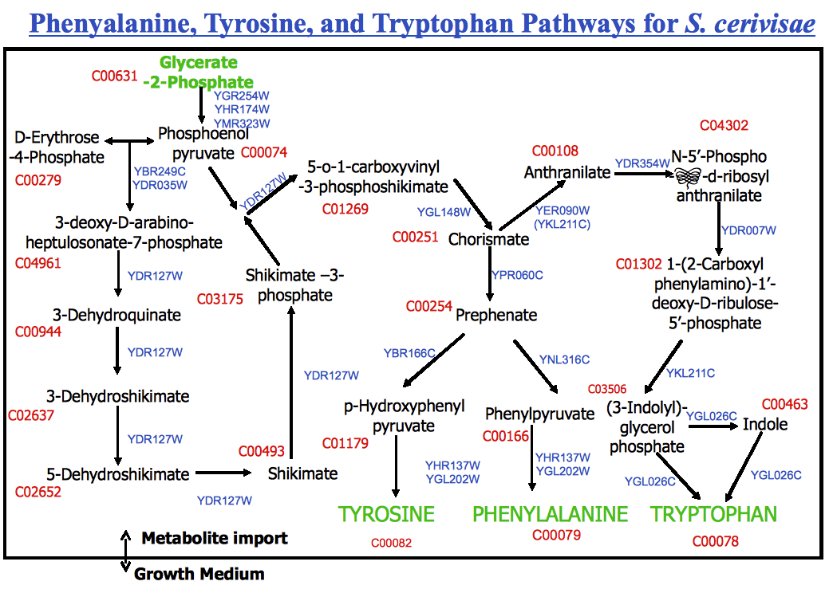
ß

Slide 15
Genome Scale Model of
Yeast Metabolism
It covers most of what is known about yeast metabolism.
Includes 1,166 ORFs (940 known, 226 inferred).
Growth if path from growth medium to defined end-points.
State-of-the-art accuracy in predicting cell viability.
Now integrated with Yeast 4.0.

Slide 16
The Experimental Cycle
Background Knowledge
Hypothesis Formation
Analysis
Consistent
Hypotheses
Experiments(s)
Experiment(s) selection
Final Theory
Robot
Results
Interpretation

Slide 17
Locally Orphan Enzymes
Adam’s model of yeast metabolism has “locally orphan enzymes” these catalyse biochemical reactions known to be in yeast, but for which the coding genes are unknown.
Adam uses bioinformatic methods to abduce genes which could encode these orphan enzymes - hypotheses.

Slide 18
Automated Model Completion
Model of
Metabolism
Hypothesis
Formation
Experiment
Formation
REACTION
Bioinformatics
Database
?
Experiment
+
FASTA32
PSI-BLAST
Gene Identification
Deduction
orthologous(Gene1, Gene2) → similar_sequence(Gene1, Gene2).
Abduction
similar_sequence(Gene1, Gene2) → orthologous(Gene1, Gene2).
Notes:
* Explain experimental cycle

Slide 19
ß
?

Slide 20
The Experimental Cycle
Background Knowledge
Hypothesis Formation
Analysis
Consistent
Hypotheses
Experiments(s)
Experiment(s) selection
Final Theory
Robot
Results
Interpretation

Slide 21
The Form of the Experiments
Hypothesis 1: Gene YER152C codes for the enzyme the reaction: chorismate → prephenate.
Hypothesis 2: Gene YGL060W codes for the enzyme the reaction: chorismate → prephenate.
These can be tested by:
  Growing YER152CΔ in environment +/- prephenate.
  Growing YGL060WΔ in environment +/- prephenate.

Slide 22
ß
?

Slide 23
The Experimental Cycle
Background Knowledge
Hypothesis Formation
Analysis
Consistent
Hypotheses
Experiments(s)
Experiment(s) selection
Final Theory
Robot
Results
Interpretation

Slide 24
Adam
One of the most sophisticated pieces of laboratory automation in the world.
Designed to fully automate yeast growth experiments.
Has a -20C freezer, 3 incubators, 2 readers, 3 liquid handlers, 3 robotic arms, 2 robot tracks, a centrifuge, a washer, an environmental control system, etc.
Is capable of initiating ~1,000 new experiments and >200,000 observations per day in a continuous cycle.

Slide 25
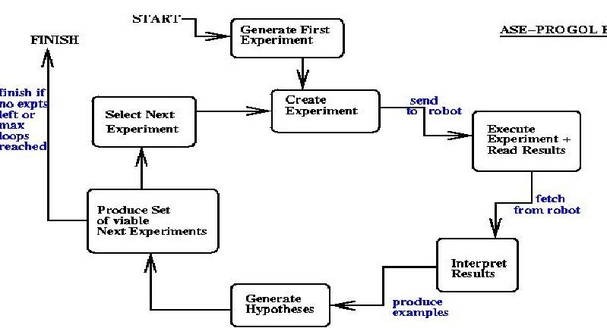
LIMS Setup

Slide 26
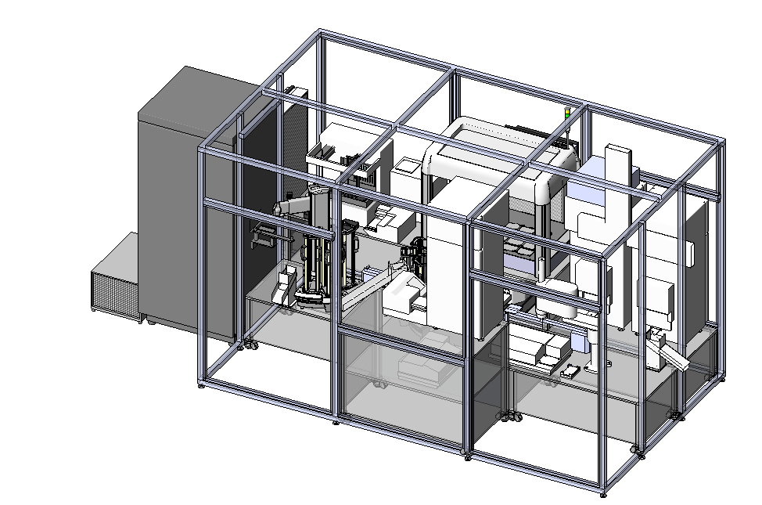
Diagram of Adam

Slide 27
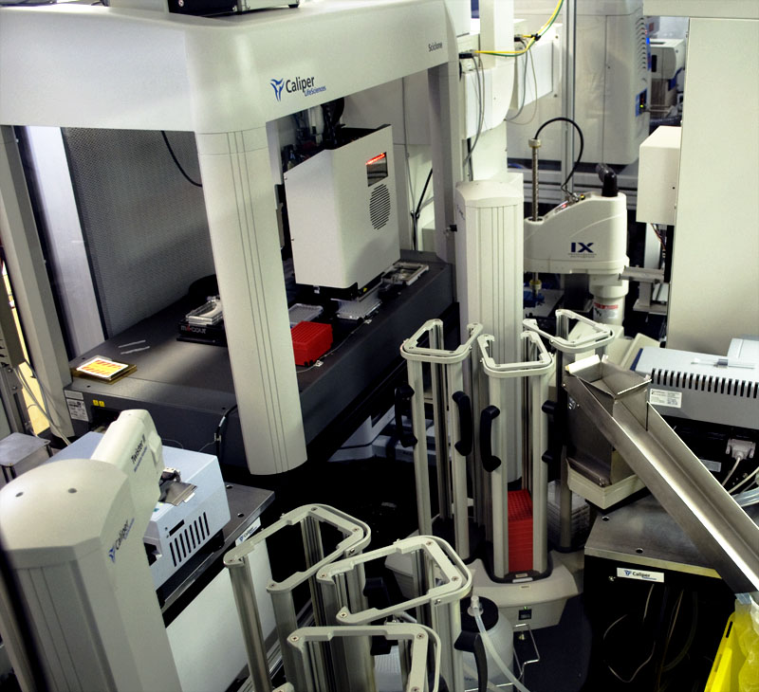
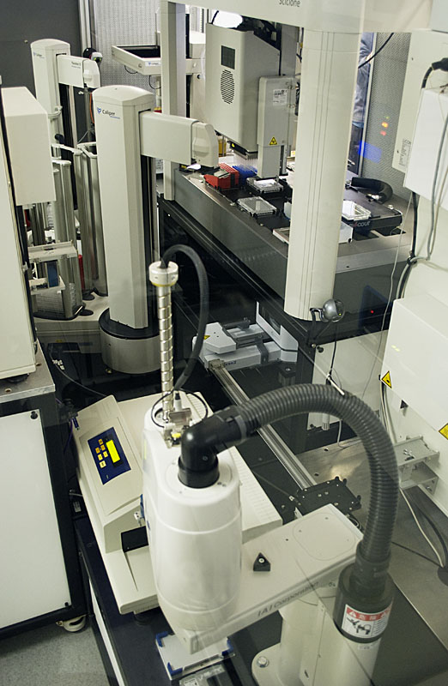
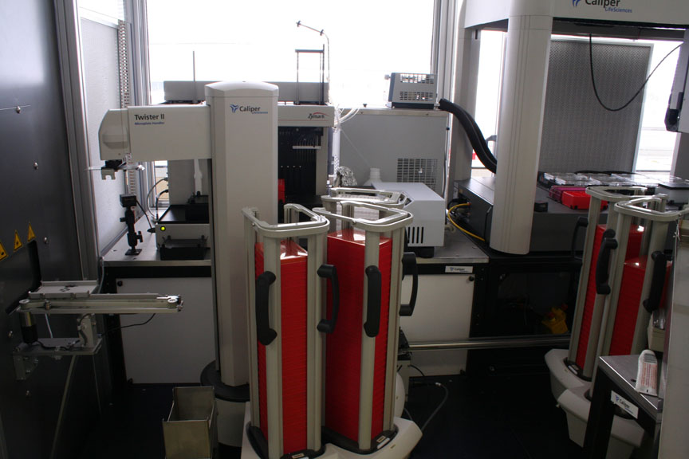
Adam

Slide 28
Adam in Action

Slide 29
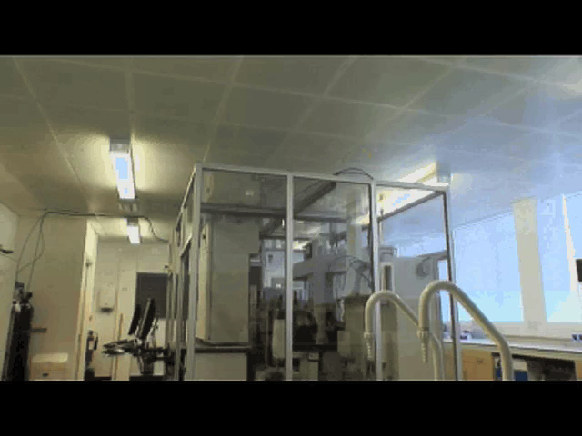

Slide 30
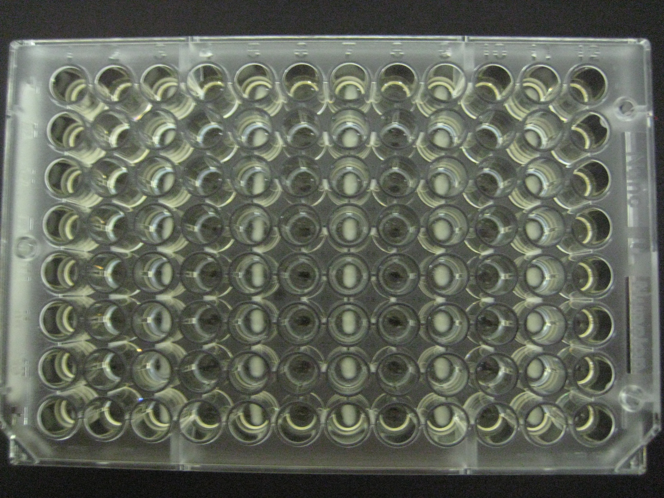
Growth plates

Slide 31
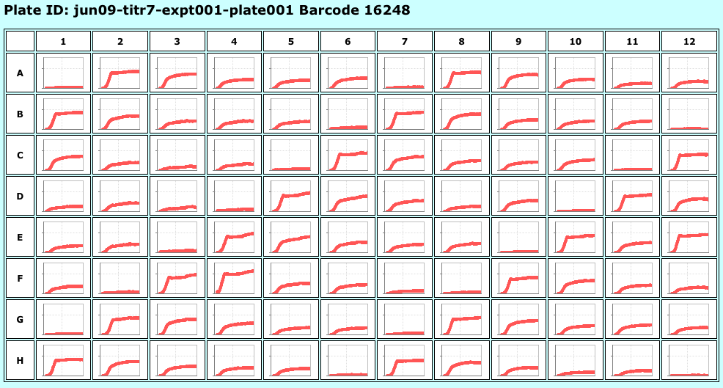
Example Growth Curves
Arginine as N source

Slide 32
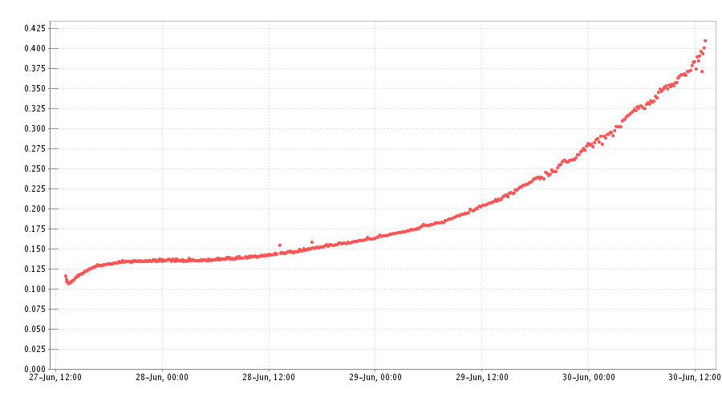
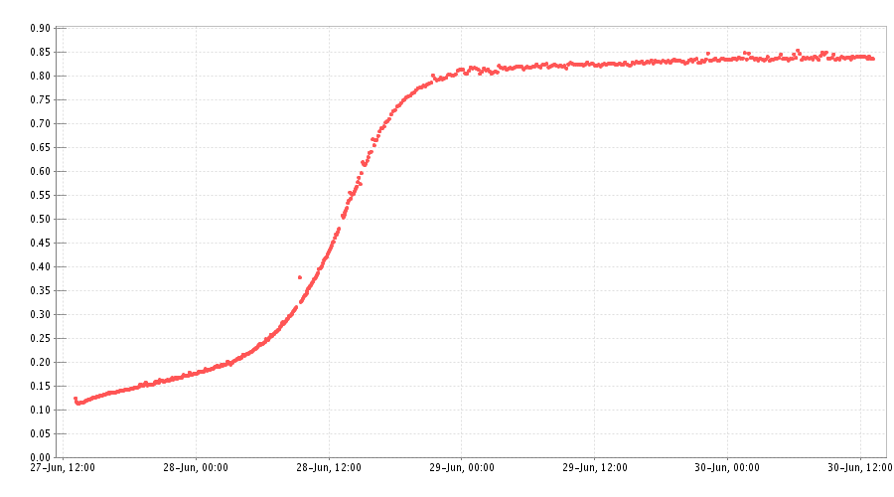
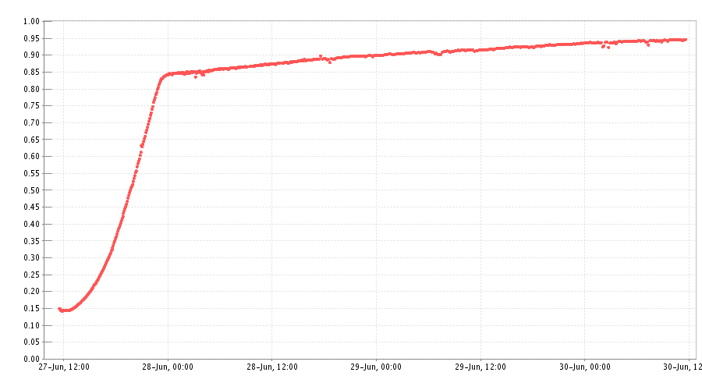
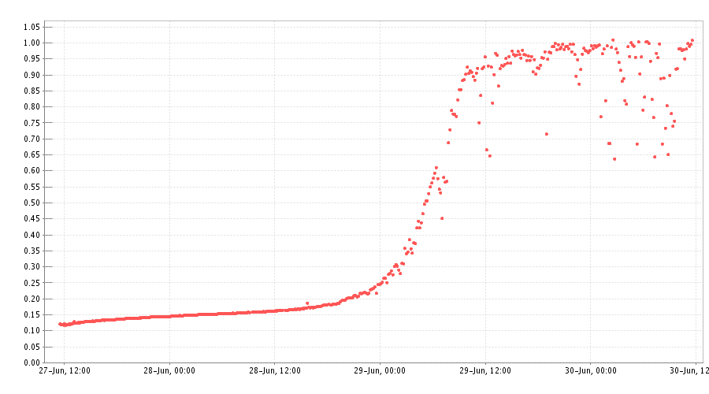
Growth curves
OD
OD
Time
Time
OD
OD
Time
Time

Slide 33
The Experimental Cycle
Background Knowledge
Hypothesis Formation
Analysis
Consistent
Hypotheses
Experiments(s)
Experiment(s) selection
Final Theory
Robot
Results
Interpretation

Slide 34
Qualitative to Quantitative
The functions of most genes in S. cerevisiae that when deleted result in auxotrophy (no growth) have already been discovered.
Most genes of unknown function only affect growth quantitatively.
They may have slower growth (bradytrophs), faster growth, higher/lower biomass yield, etc.

Slide 35
The Experimental Cycle
Background Knowledge
Hypothesis Formation
Analysis
Consistent
Hypotheses
Experiments(s)
Experiment(s) selection
Final Theory
Robot
Results
Interpretation

Slide 36
Discovery of Novel Science

Slide 37
Novel Science
Adam generated and confirmed twelve novel functional-genomics hypotheses concerning the identify of genes encoding enzymes catalysing orphan reactions in the metabolic network of the yeast S. cerevisiae.
Adam's conclusions have been manually verified using bioinformatic and biochemical evidence.

Slide 38
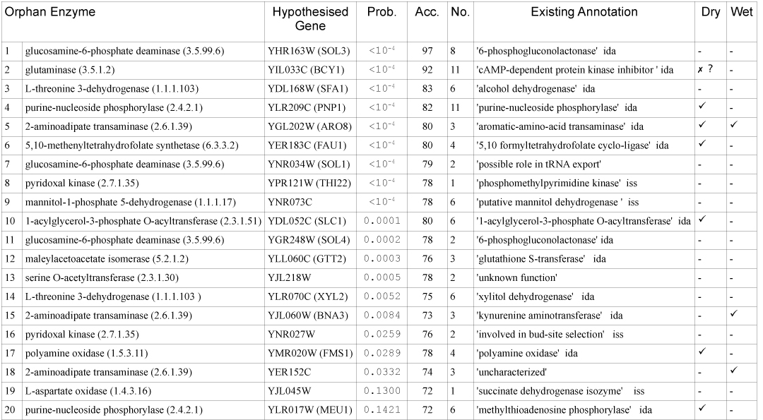
Novel Scientific Knowledge

Slide 39
A 50 Year Old Puzzle
The enzyme 2-aminoadipate: 2-oxoglutarate aminotransferase was a locally orphan enzyme.
It is in the lysine biosynthesis pathway which has been studied for 50 years in fungi: target for antibiotics, and on path to penicillin.
Adam formed three hypotheses for the gene to encode this enzyme: YER152C, YJL060W, and YGL202W (in that order of probability).
Currently KEGG states that YGL202W is the gene.
Evidence from 1960’s that at least 2 isoenzymes are involved.

Slide 40
Confirmed New Knowledge
Adam’s differential growth experiments were consistent with all three genes encoding 2-oxoglutarate aminotransferase.
Manual experiments: purified protein + enzyme assays are consistent.
  YGL202W literature confirmed.
  YJL060W (was annotated as an arylformamidase, new (08) annotation kynurenine aminotransferase)
  YER152C (currently not annotated)
YGL202W & YJL060W double knockout is lethal

Slide 41
Adam’s current work

Slide 42
Learning Systems Biology
The goal is to get Adam to automatically improve its state-of-the-art FBA model by designing new experiments.
The experiments are “perturbation” growth experiment
  remove gene(s)
  add metabolite.
Combines ideas from logical and FBA modelling

Slide 43
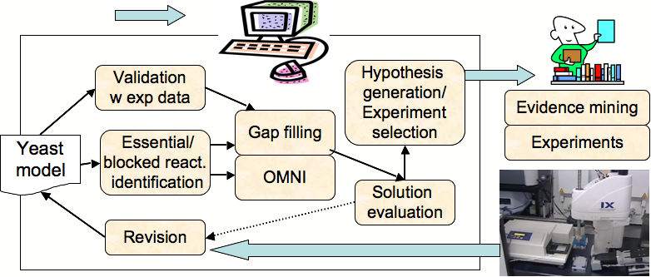
Overview

Slide 44
Formalising Biology

Slide 45
Formalization of Science
The goal of science is to increase our knowledge of the natural world through the performance of experiments.
This knowledge should, ideally, be expressed in a formal logical language.
Formal languages promote semantic clarity, which in turn supports the free exchange of scientific knowledge and simplifies scientific reasoning.

Slide 46
Robot Scientist & Formalisation
Robot Scientists provide excellent test-beds for the development of methodologies for formalising science.
Using them it is possible to completely capture and digitally curate all aspects of the scientific process.
The ontology LABORS is designed to enable the open access of the Robot Scientist experimental data and metadata to the scientific community.
Soldatova et al. (2006) Bioinformatics

Slide 47
Adam’s Investigations
This formalisation involves >10,000 different research units in a nested tree-like structure 11 levels deep.
It logically connects >6.6 million OD600_{nm} measurements to hypotheses, experimental goals, results, etc.
No previous large-scale experimental work has been so comprehensively described and recorded.

Slide 48
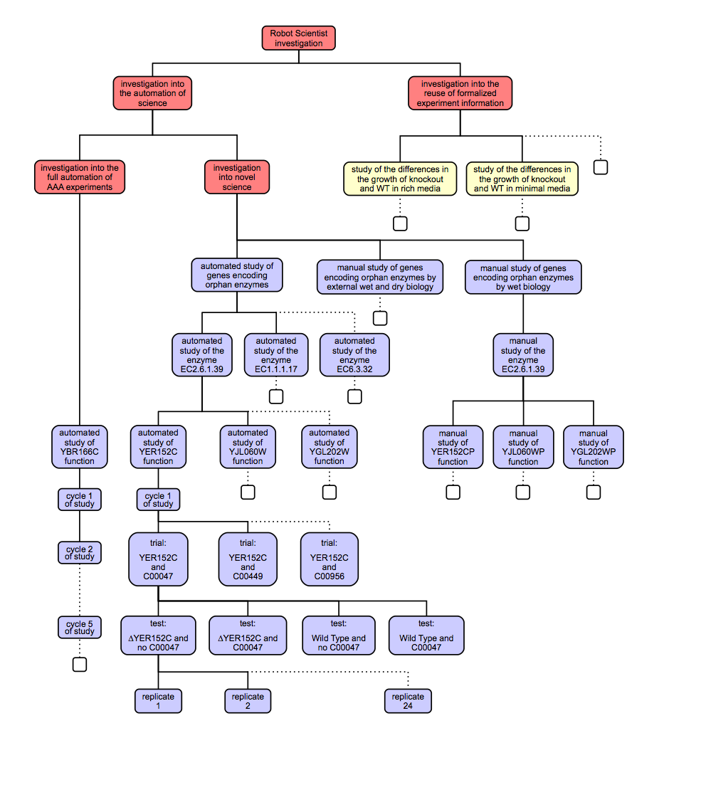

Slide 49
Levels in the Formalisation
Investigation into the automation of Science
Investigation into the automation of novel science
Investigation into the automated discovery of genes encoding orphan enzymes
Automated study of E.C.2.6.1.39 encoding
Cycle 1 of automated study of YER152C function
YER152C and Lysine automated trial
Experiment 1 (wild-type no metabolite)
Replicate 1 (well)
Observation 1

Slide 50
automated study of yer152c function
automated study: automated study of yer152c_function
has domain of study: functional genomics
has investigator = robot scientist Adam
has goal: 'To test the hypothesis that gene YER152C encodes an enzyme with enzyme class E.C.2.6.1.39'.
has organism of study: Saccharomyces Cerevisiae
has ncbi taxonomy ID: 4932
has hypotheses-set:
has research hypothesis 1: encodes(yer152c,ec_2_6_1_39)
has negative hypothesis 2: not encodes(yer152c,ec_2_6_1_39)
has cycle 1 of study
has study result: the strength of evidence that encodes(yer152c,ec_2_6_1_39):
highest accuracy of random forest evidence: 74%
proportion of random forest evidence >=70%: 2/3
has study conclusion: hypothesis 1 confirmed
has text representation:
a:automated study(X) :- a:automated_study_of_yer152c_function.
a:hypotheses-set(X) :- a:research_hypothesis(X).
a:cycle_of_study(X) :- a:cycle_1_of_study_(X).
a:hypotheses-set(X) :- a:negative_hypothesis(X).
a:domain_of_study(Y) :- a: automated study(X), a:has_ domain_of_study(X,Y).
a:investigator(Y) :- a: automated study(X), a:has_ investigator(X,Y).
a:goal(Y) :- a: automated study(X), a:has_goal(X,Y).
a:organism_of_study (Y) :- a: automated study(X), a:has_organism_of_study(X,Y).
a:hypotheses-set(Y) :- a: automated study(X), a:has_hypotheses-set(X,Y).
a:cycle_of_study(Y) :- a: automated study(X), a:has_cycle_of_study(X,Y).
a:study_result(Y) :- a: automated study(X), a:has_study_result(X,Y).
a:study_conclusion(Y) :- a: automated study(X), a:has_study_conclusion(X,Y).
a:domain_of_study(X) :- a:functional_genomics.
a: investigator(X) :- a:adam.
a:goal(X) :- a: to_test_the_hypothesis_that_gene_YER152C
_encodes_an_enzyme_with_enzyme_class_E_C_2_6_1_39.
a:organism_of_study(X) :- a:saccharomyces_cerevisiae.
a:study_result(X) :- a:the_strength_of_evidence_of_hyypothesis_1.
a:study_conclusion(X) :- a:hypothesis_1_confirmed.
has datalog representation:
<?xml version="1.0"?>
<rdf:RDF
xmlns="http://www.owl-ontologies.com/Ontology1204198571.owl#"
<owl:Class rdf:ID="goal"/>
<owl:Class rdf:ID="study_result"/>
<owl:Class rdf:ID="ncbi_taxonomy_ID"/>
<owl:Class rdf:ID="cycle_of_study"/>
<owl:Class rdf:ID="negative_hypothesis">
<rdfs:subClassOf>
<owl:Class rdf:ID="hypotheses-set"/>
</rdfs:subClassOf>
</owl:Class>
<owl:Class rdf:ID="domain_of_study"/>
<owl:Class rdf:ID="organism_of_study"/>
<owl:Class rdf:ID="cycle_1_of_study_">
<rdfs:subClassOf rdf:resource="#cycle_of_study"/>
</owl:Class>
<owl:Class rdf:ID="automated_study">
<rdfs:subClassOf>
<owl:Restriction>
<owl:someValuesFrom rdf:resource="#goal"/>
<owl:onProperty>
<owl:ObjectProperty rdf:ID="has_goal"/>
</owl:onProperty>
</owl:Restriction>
</rdfs:subClassOf>
<rdfs:subClassOf>
<owl:Restriction>
<owl:someValuesFrom rdf:resource="#organism_of_study"/>
<owl:onProperty>
<owl:ObjectProperty rdf:ID="has_organism_of_study"/>
……………………………………………………….
has OWL representation:

Slide 51
Conclusions
Automation is becoming increasingly important in scientific research e.g. DNA sequencing, drug design.
The Robot Scientist concept represents the logical next step in scientific automation.
The Robot Scientist Adam is the first machine to have discovered novel scientific knowledge.
Scientific knowledge should be formalised to ensure the comprehensibility, reproducibility, and free exchange of knowledge with human and robot scientists.

Slide 52
Acknowledgments
ABERYSTWYTH
Wayne Aubrey
Amanda Clare
Douglas Kell
Maria Liakata
Chuan Lu
Magda Markham
Katherine Martin
Ronald Pateman
Jem Rowland
Andrew Sparkes
Larisa Soldatova
Mike Young
Ken Whelan
CAMBRIDGE
Elizabeth Bilsland
Steve Oliver
Pınar Pir

