Slide 1
IT ISN’T SCIENCE UNTIL IT’S MATHEMATICS!

Slide 4
INTERESTING MATHEMATICS
BIO-
INFORMATICS
THEORETICAL
PHYSICS
MATHEMATICAL
NEUROSCIENCE
GENETICS
CURES
FOR THE SICK
“WHY ARE WE
HERE?” QUESTIONS

Slide 6
Mathematics is the art of giving the same name to different things - Henri Poincaré

Slide 7
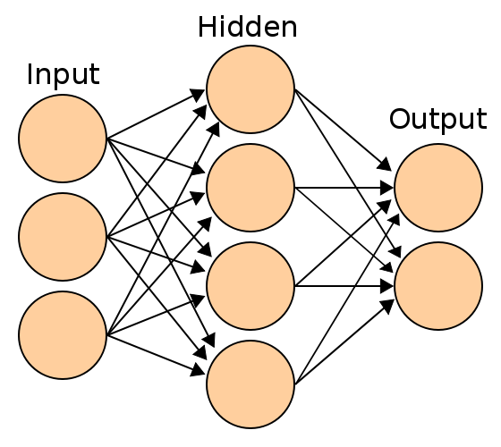
Picture from wikipedia

Slide 8
NEURONS HAVE HUGE NUMBERS OF CONNECTIONS
Purkinje cell drawing by Santiago Ramón y Cajal

Slide 9
THIS TALK:
THE BRAIN IS AMAZING SO TRYING TO UNDERSTAND IT WILL MEAN AMAZING NEW MATHEMATICS.
2) SOME OF THAT NEW MATHEMATICS WILL INVOLVE SHANNON’S INFORMATION THEORY.

Slide 11
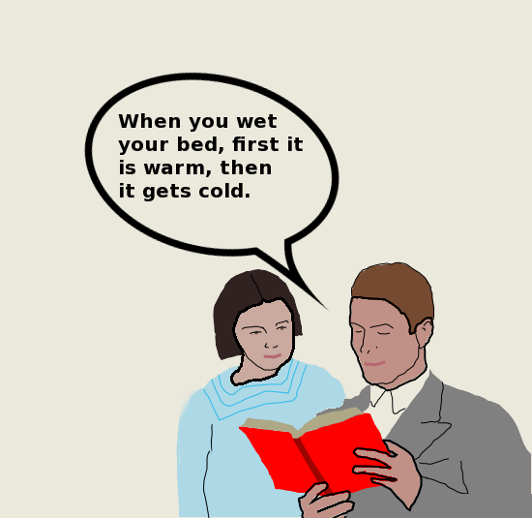

Slide 12
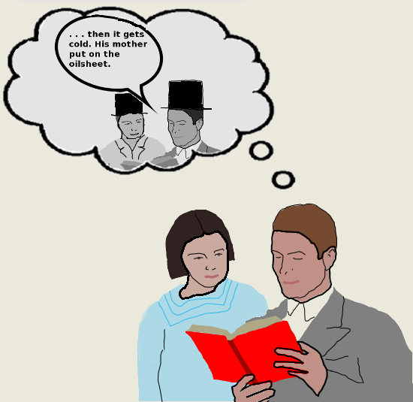

Slide 16
COMPUTATION IN THE BRAIN IS MYSTERIOUS, COMPLICATED AND IMPRESSIVE.

Slide 17
There is interesting mathematics to be discovered in the brain.
Interesting mathematics is needed to understand the brain.

Slide 18
THE MISSING MATHEMATICS OF NEUROSCIENCE IS SOMETHING TO DO WITH INFORMATION, DATA AND SIGNAL PROCESSING

Slide 20
Information is the resolution of uncertainty. – Claude Shannon

Slide 21
http://www.youtube.com/watch?v=Efgy1bV2aQo

Slide 44
P(harp)=1/2
P(dog)=1/2
H=1

Slide 45
P( )=1/6
P( )=5/6
H=0.65

Slide 48
http://www.youtube.com/watch?v=5hcKa86WJbg

Slide 50
IN A ROOM WITH 57 PEOPLE THERE IS A 99% CHANCE TWO HAVE THE SAME BIRTHDAY.

Slide 52
“The current of life which runs in our eyes or ears is meant to run out at our hands, feet or lips.” – William James

Slide 54
Mathematics Is Biology's Next Microscope, Only Better; Biology Is Mathematics' Next Physics, Only Better
Joel Cohen

